Slide 1
Using Harm Reduction Approaches to Improve Treatment of Opioid Use Disorder With Buprenorphine
Bruce G. Trigg, MD
Addiction Medicine and Public Health Consultant
Department of Health, New York City, USA

Slide 2
Disclosure information
I have no financial or other potential conflicts of interest to declare.

Slide 3
Objectives
Review the current opioid overdose and opioid use disorder (OUD) epidemics in USA.
Explain the benefits of Medication for Addiction Treatment (MAT)
Describe how buprenorphine is used to treat OUD

Slide 4
Twin Epidemics
Opiate addiction (also called Opioid Use Disorder or OUD) to pain medications and heroin
Drug overdose deaths

Slide 9
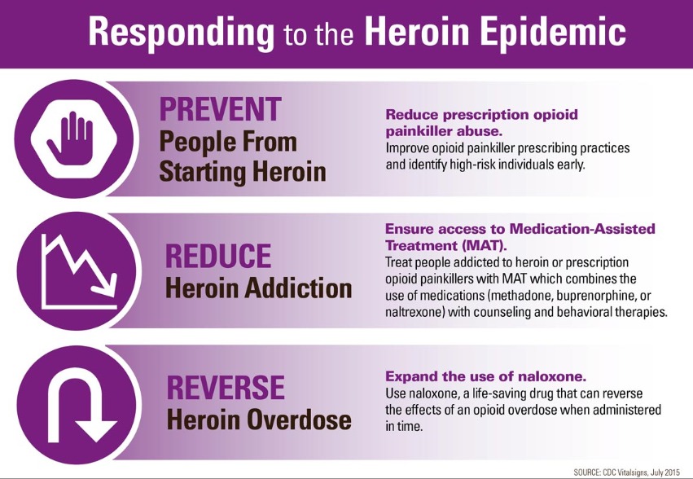
Notes:
Responding to the Heroin Epidemic
Hand up icon, indicating a command to stop
PREVENT People From Starting Heroin
Reduce prescription opioid painkiller abuse.
Improve opioid painkiller prescribing practices and identify high-risk individuals early.

Slide 11
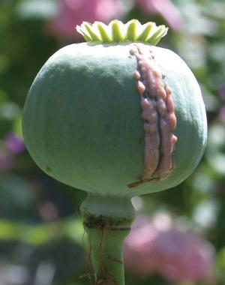


Slide 12
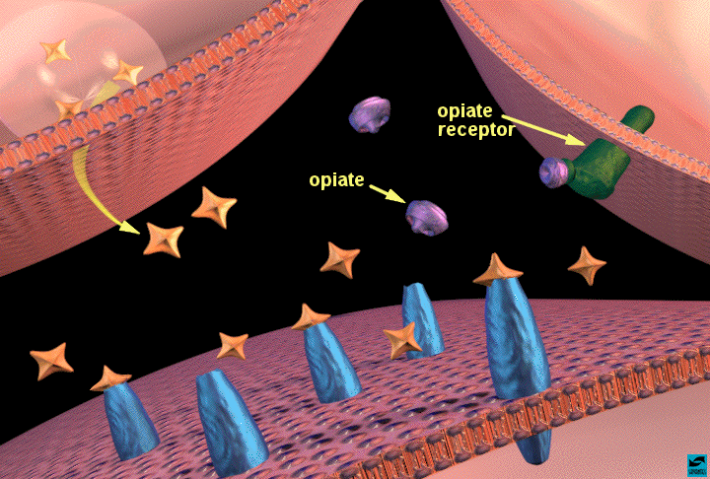

Slide 14
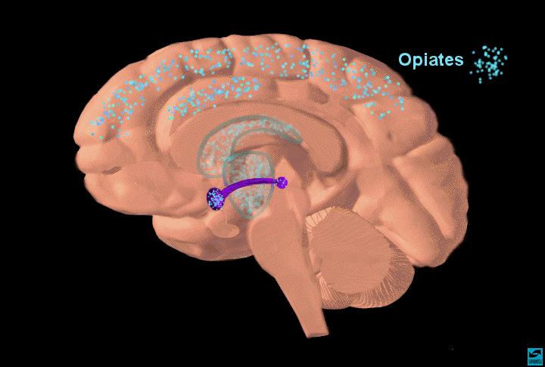

Slide 15
Opioid Use Disorder (OUD)
WHO ICD-10 and DSM 5 Definitions
3 C’s for at least 12 months
  Loss of Control
  Compulsive use
  Continued use despite negative Consequences

Slide 16
MAT
Medication for Addiction Treatment

Slide 17
What is MAT?
MAT combines pharmacological intervention with psychosocial support to treat addiction.

Slide 18
Why MAT?
Because detox without MAT maintenance is rarely successful for preventing relapse
Very high (70 to 90%) relapse rate after “abstinence-based” treatment.
Increased risk of overdose death after abstinence - due to loss of tolerance.
Overdose death rates dramatically increase after re-entry from incarceration or abstinence-based rehab

Slide 19
Medication for Addiction Treatment
A medical model for the treatment of opiate dependence.
Treats opioid dependence as a chronic, relapsing disease (like diabetes or high blood pressure).
Uses a long-acting, legal, non-injected opioid medication to prevent withdrawal, minimize craving, and block the use of opiates.
Most effective medications – methadone or buprenorphine (also called Opioid Agonist Treatment or OAT)

Slide 20
Three FDA Approved Medications for MAT
Methadone
Buprenorphine
Naltrexone

Slide 21
Low OD Risk with Buprenorphine
Agonist: Methadone,
Heroin, etc.
Respiratory suppression, death
Opioid
Effects
Partial Agonist: Buprenorphine
Antagonist: Naltrexone
Log dose
Notes:
21

Slide 22
Does MAT Replace One Addiction for Another?
NO! Addiction is compulsive use of a drug despite the harm caused by its use.
Most people on MAT dramatically decrease and most will eventually stop all use of opiates.
They are able to address other mental health, medical and social problems in their lives.
Most lead normal healthy lives but success requires continuation of treatment including linkage to psychosocial support services when needed.

Slide 23
Methadone
First used as treatment of opioid use disorder in USA in 1966. FDA approved in 1972
Oral opioid agonist given daily in special addiction clinics (OTP)
Highly effective in reducing heroin use with associated decreases in risk behaviors
Gold standard in treatment of opioid use disorders

Slide 24
Methadone Use Globally
Endorsed in 2004 by WHO, UNODC and UNAIDS (Joint United Nations Programme on HIV/AIDS) in a joint position paper.
Methadone and buprenorphine are on the WHO Model List of Essential Medications
Methadone or buprenorphine used in 86 countries in 2018

Slide 25
Methadone Regulation in USA
Can only be dispensed by licensed Opioid Treatment Programs (OTPs)
Must follow federal and state regs
Requires daily dispensing (six days a week) for first 90 days
By one year can receive up to 2 weeks of take-home doses
Eventually may receive 14 to 30 day supply

Slide 26
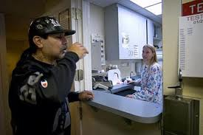
Person taking methadone in a regulated clinic

Slide 27
History of Buprenorphine in US
First synthesized as an analgesic in 1966 in England
Recognized as potential addiction treatment by US government researchers, 1970s
Designed for treatment in primary care practices and to be prescribed by OTPs
Approved by the US Government, 2002

Slide 28
Regulation of Buprenorphine in USA
Government at first allowed only qualified physicians to prescribe.
Since 2016, advance practice practitioners (Nurse Practitioners and Physician Assistants) can prescribe
Requires special training/certification. 8 hrs for physicians and 24 hrs for Advance Practitioners
Limits number of patients a provider can have in treatment in the first year to 30.
After 1 year can apply to have up to 100 patients. In special situations can have up to 275 patients.
Notes:
1. Use of buprenorphine for these short periods is effective for the suppression of opioid withdrawal symptoms – especially when compared to clonidine.
2. However, the long-term outcome from such short period withdrawals is not known. In general, clinical experience indicates that short term opioid withdrawal treatment does not lead to long-term opioid abstinence (regardless of the medication used).

Slide 29
Buprenorphine Formulations
Buprenorphine + naloxone
Naloxone lowers abuse potential → causes withdrawal if other opiates are present
    Naloxone not active when taken by sublingual route
Buprenorphine without naloxone (Subutex)
    Used during pregnancy
Sublingual film (Suboxone)
Buccal film (Bunavail)
Generic tablets (Zubsolv)
Monthly injection (Sublocade)
Q6 month implants (Probuphine)

Slide 30
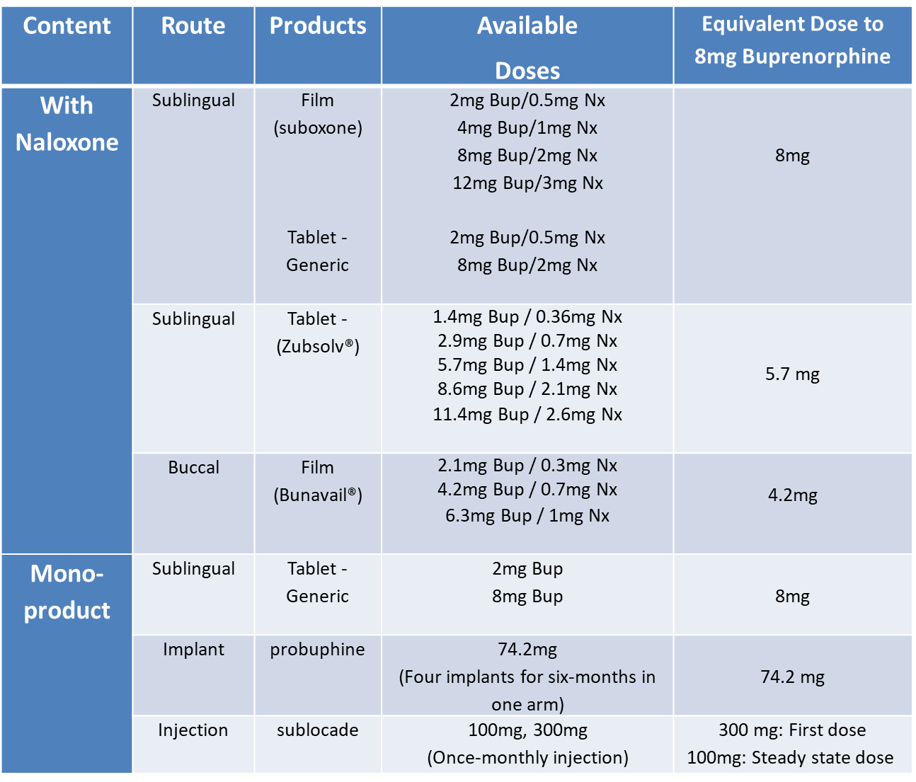
Buprenorphine Formulations for
Opioid Use Disorder
Notes:
Speaker Notes:
The goal of this “busy” slide is NOT to read every cell of the table but to provide an easily accessible resource for providers
This table provides information of available buprenorphine formulations, their doses, route of administration and equivalency dosing
Probuphine: Four Subdermal (under the skin) implants delivers a constant dose of buprenorphine equivalent to about 8mg SL daily over a six-month time span implanted in one arm
Note: Belbuca® (buprenorphine) buccal film is indicated for the management of pain and not opioid use disorder and is thus omitted from this table
Note: On 11/30/17 the FDA approved the first once-monthly buprenorphine injection for Opioid Use Disorder

Slide 31
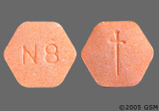
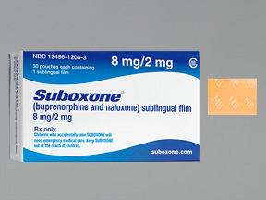
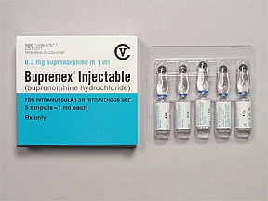
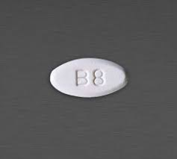

Slide 32
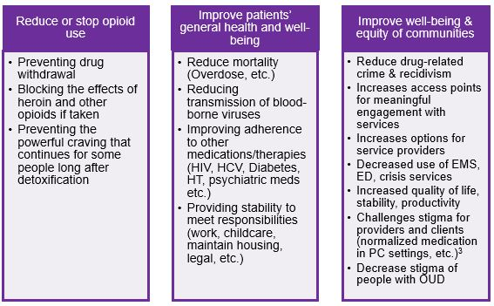
Benefits of Buprenorphine

Slide 33
RCT of Buprenorphine
Buprenorphine 8mg/day vs taper + placebo
All received group counseling
Followed for 1 year
 | Buprenor-phine | Placebo
Retained at 1 yr | 70% | 0
% died | 0 | 20%
Kakko et al, Lancet 2003
Notes:
33
Study consisting of 40 people

Slide 34
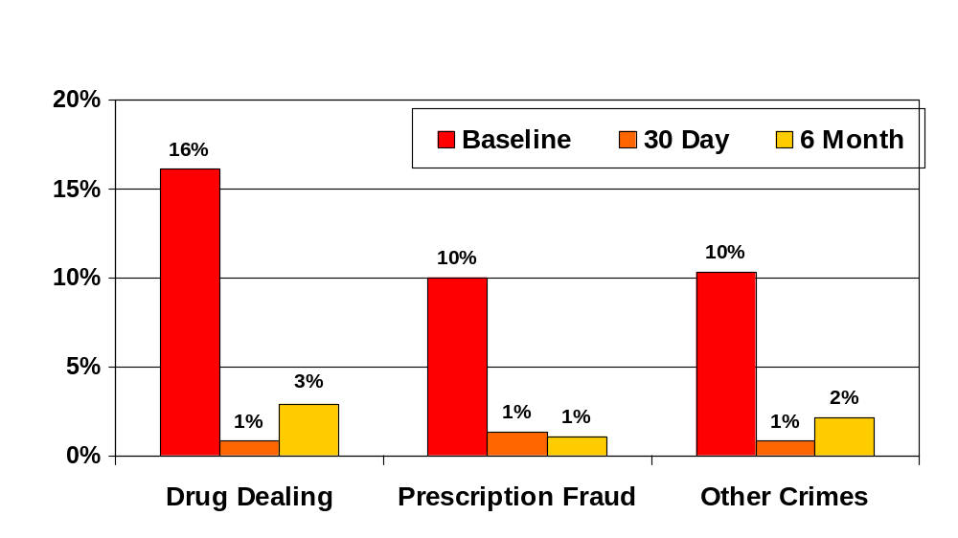
Buprenorphine Patient Outcomes:
Specific Criminal Activities
Percent of Patient Sample
n=379
SAMHSA Patient Longitudinal Study, 2005

Slide 35
Opioid overdose deaths and buprenorphine treatment: Baltimore, MD 1995-2009
American Journal of Public Health, 2013
Notes:
Overdose deaths in Baltimore:
•Researchers found a statistically significant inverse relationship between heroin overdose deaths and patients treated with buprenorphine

Slide 36
Buprenorphine vs Methadone
Like methadone…
Reduces IVDU
Retains patients in treatment
Decreases craving
Stops withdrawal
Costs $ 5-13 per day
Unlike methadone….
Low potential for OD
Prescribed in MD office
Less sedation
Easy taper/detox
Notes:
36

Slide 37
Annals of Internal Medicine
SPECIAL ARTICLE
The Next Stage of Buprenorphine Care for Opioid Use Disorder
Stephen A. Martin, MD, EdM; Lisa M. Chiodo, PhD; Jordon D. Bosse, MS, RN; and Amanda Wilson, MD
Ann Intern Med. doi:10.7326/M18-1652 23 October 2018.

Slide 38
Initial U.S. recommendations for buprenorphine treatment were unintentionally restrictive. These restrictions have been associated with
a shortfall of prescribers and barriers to care for patients.
Recent evidence-based recommendations more readily support initial and ongoing individualized care.
Practices and policymakers should update their approaches on the basis
of this evidence.

Slide 39
LOCATION OF BUPRENORPHINE INDUCTION
Previous Approach
A medical setting is needed for safe and effective buprenorphine induction.
New Findings and Recommendations
Home induction is safe and effective.

Slide 40
Induction and Maintenance
Induction requires 12 hours of abstinence and mild to moderate withdrawal to prevent precipitated withdrawal
Usually achieves therapeutic dose in first two to three days
Maintenance treatment most effective. Generally recommended at least one year of treatment but many will require longer period; no limit on treatment
Weekly follow up visits initially
When stable every one to two months

Slide 41
Clinical Opiate Withdrawal Scale
(COWS)
Resting Pulse
Sweating
Restlessness
GI Upset
Tremor
Pupil Size
Bone or Joint Aches
Yawning
Anxiety or Irritability
Gooseflesh
Runny Nose
or Tearing Eyes
Wesson and Ling, 2003
Notes:
Speaker Notes:
Induction Criteria include (but are not limited) to: Clinic policy about patient being in Mild/Moderate withdrawal; Coordinating any insurance prior-authorization issues; Confirming access to medications (Pharmacy)

Slide 42

Office Buprenorphine Induction
Day #1 – Short Acting Opioids
Patients dependent on short-acting
opioids (e.g. heroin/oxycodone/
hydrocodone):
Instruct patient to abstain from any opioid
use for 12 to 24 hours prior to induction
visit:
  Arrive in mild-moderate withdrawal at induction visit
Use opioid withdrawal scale (COWS > 8):
  Document and assess severity of withdrawal
  Track the patient's response to first day’s dose
Notes:
Speaker’s Notes:
Range of variability in clinical practice. Follow your clinic protocol and procedures

Slide 43
Office Buprenorphine Induction
Day #1 – Methadone
Do not start buprenorphine until the patient manifests signs of opioid withdrawal
  Waiting at least 36 hours reduces risk of precipitated withdrawal
  Lower doses of buprenorphine/naloxone are less likely to precipitate methadone withdrawal.³²⁸
    For example, once opioid withdrawal is verified, an initial dose of 2 mg/0.5 mg can be given. If patients continue to have unrelieved opioid withdrawal after the first 2 mg dose, administer another 2 mg/0.5 mg dose approximately every 2 hours as needed (holding for sedation)
  Induction should be conducted slowly; consider treating unrelieved withdrawal symptoms with nonopioid therapies as needed
  Be alert to any increase in withdrawal symptoms, as this may suggest precipitated withdrawal.
TIP 63
Notes:
Speaker Notes:
The half-life of methadone in an opioid-tolerant patient is approximately 24 hours; its half-life in an opioid-naive patient is approximately 55 hours [The duration of effect is extended in opioid-naive patients]. Reference: Grissinger M. 2011. Keeping Patients Safe From Methadone Overdoses. Pharmacy and Therapeutics. 36(8): 462-466.

Slide 44
Buprenorphine Induction
Review
First dose: 2-4 mg SL buprenorphine/naloxone
Monitor in office for 2+ hours after first dose
  Relief of opioid withdrawal symptoms should begin within 30-45 minutes after the first dose
Re-dose every 2-4 hours, if opioid withdrawal subsides then reappears
Stabilize at dose that eliminates craving; typical dose range from 8 mg to 16 mg
Gradually increase dose after establishment of a steady state over as needed for continued craving.
  Note: This can be increased more rapidly if the patient has a lot of craving.
Notes:
Speaker Notes:
Typically lower doses are utilized to relieve withdrawal and higher doses are utilized to relieve craving
Commonly practice: Aim for a dose of 8 mg in the first 24 hours

Slide 45
DURATION OF BUPRENORPHINE TREATMENT
Previous Approach
Buprenorphine treatment can readily be discontinued.
New Findings and Recommendations
Patients should receive buprenorphine as long as it provides benefit.

Slide 46
NIH Consensus
Statement 1997
“Although a drug-free state represents an optimal treatment goal, research has demonstrated that this goal cannot be achieved or sustained by the majority of opiate-dependent people.”
Effective Medical Treatment of Opiate Addiction.
NIH Consensus Statement 1997 Nov. 17-19;15(6):5

Slide 47
RELAPSE DURING BUPRENORPHINE TREATMENT
Previous Approach
Patients who experience relapse have failed buprenorphine treatment.
New Findings and Recommendations
Patients who experience relapse should be pro- vided additional support and resources rather than ces- sation of buprenorphine treatment.

Slide 48
REQUIREMENTS FOR COUNSELING
Previous Approach
Traditional counseling is needed to benefit from buprenorphine treatment.
New Findings and Recommendations
Traditional counseling is not necessary for successful outcomes in buprenorphine treatment.

Slide 49
USE OF OTHER SUBSTANCES DURING BUPRENORPHINE TREATMENT
Previous Approach
Patients who use other substances are not appropri- ate candidates for buprenorphine treatment.
New Findings and Recommendations
Buprenorphine does not have a direct effect on other substance use, and this use should generally not influence care for OUD.

Slide 50
Can Buprenorphine Be Abused?
Diversion is due, in large part, to difficulty in obtaining legal medical treatment
Not generally a preferred drug of abuse due to slow-onset of action.
Much less overdose risk than other opiate drugs and medications
Higher doses protect (“block”) from use of other opiates

Slide 51
COMBINING BUPRENORPHINE WITH A BENZODIAZEPINE
Previous Approach
Benzodiazepines and buprenorphine are a toxic combination.
New Findings and Recommendations
Withholding buprenorphine because of benzodiaz- epine use could result in harm from untreated opioid addiction that outweighs the risks of concomitant use of these medications.

Slide 52
USES OF DRUG TESTING
Previous Approach
Drug testing indicates which patients are unsuccessful and should be removed from buprenorphine treatment.
New Findings and Recommendations
Drug testing is a tool for supporting recovery rather than a method of punishment.

Slide 53
Other Barriers to care
Buprenorphine is underutilized in the US. Many patients have difficulty in getting access to treatment with buprenorphine
– Too few trained; too few trained prescribe
Stigma and misunderstanding by the public, medical, drug treatment, mental health and criminal justice workers
Punitive policies (War on Drugs) and administrative barriers
Cost of medication
Market-based health care shuns patients with chronic diseases such as OUD

Slide 55
Naltrexone
Extended-release injectable naltrexone (brand name: Vivitrol) is approved for treatment of opioid use disorder) OUD.
Less experience and fewer studies comparing directly to buprenorphine and methadone
Some positive experience with socially stable and highly motivated patients
Difficult inductions (28% failure in one inpatient study) and low retention (estimated that half of patients only receive one or two injections).
Concerns that relapse after discontinuation may increase risk of overdose
Aggressive marketing by manufacturer directly to public, to judges and sheriffs and lobbying of politicians raises ethical issues
Extended release form is very expensive ( $1,000 per month)
Conclusion: Most addiction specialists in the US consider naltrexone to be a second-line treatment for opiate addiction.

Slide 56
US Food and Drug Administration (FDA) approved medications
Medication | Euphoria | Overdose Risk | Effectiveness | Other
Methadone | Some | Low | ↓ mortality ↓ illicit opioids ↓ criminality | Good data Structured Inexpensive
Buprenorphine | Minimal | Minimal | ↓ mortality ↓ illicit opioids ↓ HIV risk | Good data Convenient Feasible
Long-acting naltrexone | None | None | ↓ illicit opioids | Minimal data Expensive
Sharma Substance Abuse & Rehabilitation 2016

Slide 57
Reasons for Making Buprenorphine Available to People With Opioid Use Disorder in Vietnam
Better to have two medications to treat a dangerous, complex, chronic disease.
Gives patients a choice of options.
Take home dosing has less risk of overdose if medication is diverted.
If less restrictive then can offer an alternative to daily, directly observed treatment at MMT.
Help to address problems with stigma, geographic access to MMT, lack of transportation, work and family responsibilities
Fewer drug-to-drug interactions with TB and ART meds (helps to avoid high doses of methadone for some patients).

Slide 58
Buprenorphine for pregnant women
Growing evidence supports buprenorphine as the preferred treatment for OUD in pregnancy. Infants whose mothers are treated with buprenorphine have a milder and shorter neonatal withdrawal (or abstinence) syndrome (NWS) than do infants whose mothers are treated with methadone.

Slide 59
THANK YOU
Bruce G. Trigg, MD
trigabov@gmail.com

