Slide 1
Evidence based treatment for ASD
Ethan Bindelglas, MD
Clinical assistant professor of family and
community medicine,
University of Arizona

Slide 2
Conflicts
I have nothing to declare

Slide 3
Early Detection = Early Intervention
If you diagnose a child at 2 years, he or she can only be 2 years delayed...

Slide 4
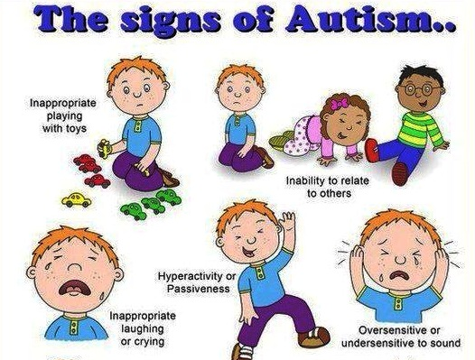

Slide 5
Frequent symptoms and signs
Lack of eye contact
Fascination with spinning objects ...preoccupations
Missing social cues
Difficulty understanding body language
Speech delay
Emotional outbursts particularly in overwhelming or unfamiliar situations
Sensory processing issues such as hypersensitive to sounds or touch

Slide 6
DSM-V synopsis
Diagnostic Criteria
  A. Persistent deficits in social communication and social interaction across multiple contexts.
    1. Deficits in social-emotional reciprocity; failure to initiate or respond to social interactions
    2. Deficits in nonverbal communicative behaviors used in social interaction; abnormalities in eye contact and body language or deficits in understanding and using gestures

Slide 7
    3. Deficits in developing, maintaining, and understanding relationships; difficulties in sharing imaginative play or in making friends.
    B. Restricted, repetitive patterns of behavior, interests, or activities as manifested by at least 2 of the following:
        1. Stereotyped or repetitive motor movements (e.g. lining up toys or flipping objects.)
        2. Insisting on sameness, inflexible adherence to routines or ritualized patterns (e.g., extreme distress at small changes)

Slide 8
      3. Highly restricted, fixated interests that are abnormal in intensity or focus
    Hyper or hyporeactivity to sensory input (e.g., apparent indifference to pain/temp, adverse response to specific sounds or textures, visual fascination with lights or movement)

Slide 9
C. Symptoms present in early developmental period
D. Clinical impairment.
E. Not better explained by intellectual disability or global developmental delay.

Slide 10
Etiology
Genetic factors with 80% heritability (Lichtenstein P, Carlstrom E, Rastam M, et al. The genetics of autism spectrum disorders and related neuropsychiatric disorders in childhood. Am J Psychiatry. 2010;167:1357–1363)
10-15% overlapping disorders such as Fragile X, Tuberous Sclerosis, etc...(Ghosh A, Michalon A, Lindemann L, et al. Drug discovery for autism spectrum disorder: challenges and opportunities. Nat Rev Drug Discov. 2013;12:777–790.)

Slide 11
Polygenic risk with multiple Recurrent Copy Number Variants (CNV’s) and high ASD risk genes each with minor effect
?? Valproate exposure, maternal obesity, very low birthweight, higher paternal age, prematurity and associated complications such as anoxia
Complex neurodevelopmental disorder with multifactorial with genetic and de novo mutations, environmental risk factors in prenatal, perinatal and postnatal period.
Disrupted brain development with implications of involvement in Serotonin, oxytocin, immune modulation, and GABA/glutamate systems.
Connections in Low level sensory processing affected early and likely in prenatal period
Howes OD, Rogdaki M, Findon JL, et al. Autism Spectrum Disorder: consensus guidelines on assessment, treatment and research from the British Association for Psychopharmacology. Journal of psychopharmacology (Oxford, England). 2018;32(1):3-29. doi:10.1177/0269881117741766
Clarke TK, Lupton MK, Fernandez-Pujals AM, et al. Common polygenic risk for autism spectrum disorder (ASD) is associated with cognitive ability in the general population. Mol Psychiatry. 2015

Slide 12
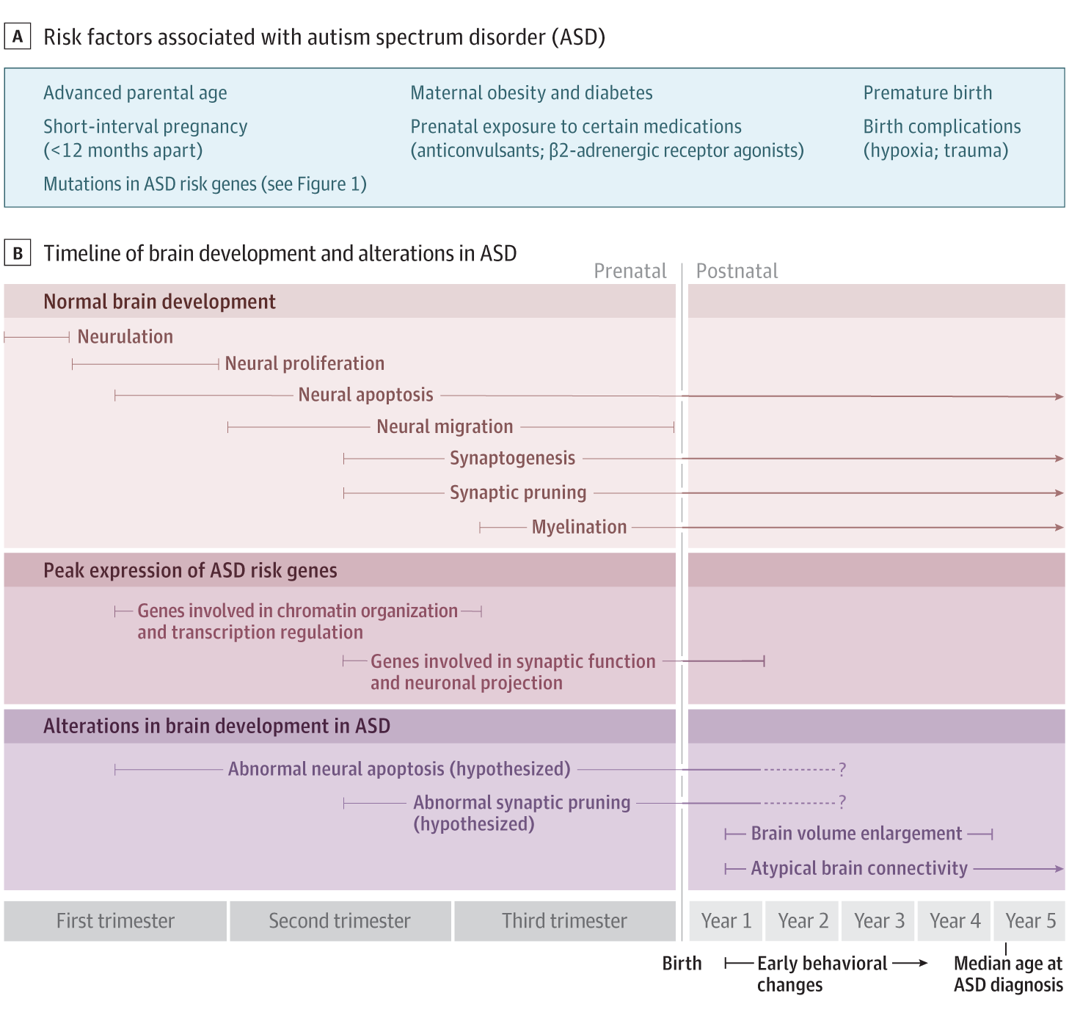
The Emerging Clinical Neuroscience of Autism Spectrum Disorder: A Review.
Muhle RA, Reed HE, Stratigos KA, Veenstra-VanderWeele J.
JAMA Psychiatry. 2018 Mar 28. doi: 10.1001/jamapsychiatry.2017.4685. [Epub ahead of print]
PMID: 29590280

Slide 13
VACCINES ARE NOT ASSOCIATED WITH AUTISM!
Meta-analysis of 5 cohort studies involving 1,256,407 children
Highlights
•
There was no relationship between vaccination and autism (OR: 0.99; 95% CI: 0.92 to 1.06).
•
There was no relationship between vaccination and ASD (autism spectrum disorder) (OR: 0.91; 95% CI: 0.68 to 1.20).
•
There was no relationship between [autism/ASD] and MMR (OR: 0.84; 95% CI: 0.70 to 1.01).
•
There was no relationship between [autism/ASD] and thimerosal (OR: 1.00; 95% CI: 0.77 to 1.31).
•
There was no relationship between [autism/ASD] and mercury (Hg) (OR: 1.00; 95% CI: 0.93 to 1.07).
•
Findings of this meta-analysis suggest that vaccinations are not associated with the development of autism or autism spectrum disorder.
Vaccines are not associated with autism: An evidence-based meta-analysis of case-control and cohort studies
Luke E.TaylorAmy L.SwerdfegerGuy D.Eslick
The Whiteley-Martin Research Centre, Discipline of Surgery, The University of Sydney, Nepean Hospital, Level 3, Clinical Building, PO Box 63, Penrith 2751, NSW, Australia
Received 29 November 2013, Revised 16 April 2014, Accepted 23 April 2014, Available online 9 May 2014

Slide 14
Treatment options
Behavioral and Speech
Pharmacotherapy
Diet
Novel

Slide 15
Behavioral Therapies
ABA
CBT

Slide 16
Applied behavioral analysis
1987 study by Lovaas: 60 children divided into 3 groups
1) 40 hours per week of intensive intervention
2) 10 hours per week with special ed
3) special ed
Results: 1) 89% substantial improvement with 47% best outcome
2) 42% improvement and no best
3) 5% best outcome

Slide 17
What is it?
Applying the scientific study of behavior to produce solutions to problems of social significance.
Socially significant behaviors include: reading, academics, social skills, communication, and adaptive living skills.
Objectively defines behaviors so they can be measured reliably

Slide 18
How is it used?
To increase behaviors such as on-task behavior or social interactions
To teach new skills
To maintain behaviors such as self control
To generalize behaviors
To reduce interfering behaviors such as self injury.

Slide 19
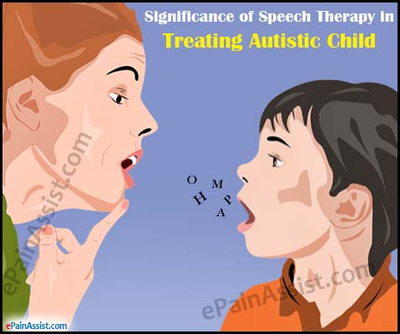

Slide 20
CBT
CBT can treat anxiety symptoms in school age children without cognitive or language delay
Not a treatment for ASD itself.
Help them change the way they think to improve how they feel.

Slide 21
Pharmaco therapy
Melatonin for sleep
Dopamine blockers for irritability
Methylphenidate, atomoxetine and quanfacine for ADHD

Slide 22
What’s missing
NO recommended pharmaco therapy for core symptoms of ASD
AMA
Howes OD, Rogdaki M, Findon JL, et al. Autism Spectrum Disorder: consensus guidelines on assessment, treatment and research from the British Association for Psychopharmacology. Journal of psychopharmacology (Oxford, England). 2018;32(1):3-29. doi:10.1177/0269881117741766.

Slide 23
Pharmaco Therapy for Core symptoms
Repurposing other psych meds
  SSRI trials: largely neg in children with more consistency and reduction of repetitive behaviors in adults with the use of fluoxetine.
  Glutamatergic agents: mGluR5 antagonist trial no effect. No current evidence: Memantine no clinical efficacy.

Slide 24
GABAergic agents:
  Arbaclofen activates GABA and inhibits glutamate
    3 trials (1 in fragile x) all slightly different results
    1) no difference in primary outcome, but post hoc analysis improvement in social avoidance
    2) Improvement in irritability and lethargy
    3) no change in social withdrawal, but improvement in secondary outcome and CGI severity

Slide 25
Pregnenalone:
  Neurosteroid which positively modulates GABAA Recptors.
  1 small unblinded study showed improvement in secondary outcome—lethargy social withdrawal scale

Slide 26
Co-Morbidities
69% to 79% have at least one other psychiatric condition during their lifetime.
Irritability, Self Injurious behavior, and temper tantrums occur in 85% of children with ASD.
Anxiety is seen in 42%-55% of ASD children.
ADHD occurs in 28% to 53%.
Sleep problems occur in 50%-80%

Slide 27
Antipsychotics
Risperidone:
  D2 receptor antagonist and is approved for treatment of irritability in ASD
  RUPP and RUPP2 showed greater decreases in ABC-Lethargy/Social Withdrawal and hyperactivity scores
  In a study of combination parent training and medication vs medication, combination was superior
Research Units on Pediatric Psychopharmacology Autism Network. Medication and Parent Training in Children with Pervasive Developmental Disorders and Serious Behavior Problems: Results from a Randomized Clinical Trial. Journal of the American Academy of Child and Adolescent Psychiatry. 2009;48(12):1143-1154. doi:10.1097/CHI.0b013e3181bfd669.

Slide 28
Aripiprizole:
  D2 dopamine receptor antagonist with partial agonist properties is FDA approved for irritability in ASD
  Modest improvement in repetitive behaviors (evidence IIa), but only (20% improvement vs placebo) modest clinical improvement
  Both have substantial risk of AE such as sedation, weight gain, tremor, and eps.
Line-item analysis of the Aberrant Behavior Checklist: results from two studies of aripiprazole in the treatment of irritability associated with autistic disorder.
Aman MG, Kasper W, Manos G, Mathew S, Marcus R, Owen R, Mankoski R.
J Child Adolesc Psychopharmacol. 2010 Oct;20(5):415-22. doi: 10.1089/cap.2009.0120.
PMID: 20973712

Slide 29
ADHD symptoms
Methylphenidate has been shown to be effective in ASD children with hyperactivity greater than inattention in dose dependent fashion.
No evidence of impact on core symptoms
Cochrane review found studies to generally of poor quality and short duration.
Methylphenidate for children and adolescents with autism spectrum disorder.
Sturman N, Deckx L, van Driel ML.
Cochrane Database Syst Rev. 2017 Nov 21;11:CD011144. doi: 10.1002/14651858.CD011144.pub2. Review.

Slide 30
Other agents
A RCT of atomoxetine vs placebo found improvement in hyperactivity, but not other other sub scores. AE’s were as with other ADHD trials
RCT of extended release Guanfacine showed a 46% decline in hyperactivity vs 13% for placebo and CGI improvement of 50%.
1.
Extended-Release Guanfacine for Hyperactivity in Children With Autism Spectrum Disorder.
Scahill L, McCracken JT, King BH, Rockhill C, Shah B, Politte L, Sanders R, Minjarez M, Cowen J, Mullett J, Page C, Ward D, Deng Y, Loo S, Dziura J, McDougle CJ; Research Units on Pediatric Psychopharmacology Autism Network.
Am J Psychiatry. 2015 Dec;172(12):1197-206. doi: 10.1176/appi.ajp.2015.15010055. Epub 2015 Aug 28.

Slide 31
Oxytocin
Preclinical studies suggested that Oxytocin plays a role in social recognition, attachment and stereotyped behavior.
Clinical trials are mixed:
Trial by Guastella et al., in 2015 failed to show efficacy in primary outcome
Yatawara et al., showed significant improvement in caregiver rated social responsiveness using nasal oxytocin
Yatawara CJ, Einfeld SL, Hickie IB, et al. The effect of oxytocin nasal spray on social interaction deficits observed in young children with autism: a randomized clinical crossover trial. Mol Psychiatry. 2016;21:1225–1231.

Slide 32
Dietary interventions
Many autistic children have GI problems
Internet full of dietary interventions and therapy including Gluten free/casein free diets, as well as supplementation with probiotics, etc...
Trials of Omega-3 supplementation, N-acetylcysteine and tetrahydrobiopterin were not associated with improvement.
Systematic review by Vanderbuilt Evidence -based Practice Center found little evidence for supplement or nutritional based interventions
Nutritional and Dietary Interventions for Autism Spectrum Disorder: A Systematic Review.
Sathe N, Andrews JC, McPheeters ML, Warren ZE.
Pediatrics. 2017 Jun;139(6). pii: e20170346. doi: 10.1542/peds.2017-0346. Review.

Slide 33
New and Novel
Gut, Brain, Microbiome interaction...
Exploratory MTT with promising results showing decrease in GI sx and reporting imp of ASD sx
More clinical trials pending
Vasopressin 1a receptor antagonist in clinical trials may work similarly to oxytocin and modify social cognition in a test of emotion used with spoken language. Ongoing clinical trials ...
Kang D-W, Adams JB, Gregory AC, et al. Microbiota Transfer Therapy alters gut ecosystem and improves gastrointestinal and autism symptoms: an open-label study. Microbiome. 2017;5:10. doi:10.1186/s40168-016-0225-7

Slide 34
Tried and True
Therapy works, but only after diagnosis.
Screen early and treat early!

Slide 35
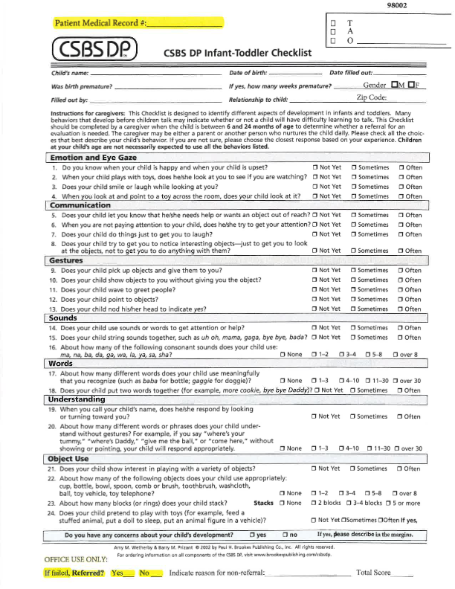

Slide 36
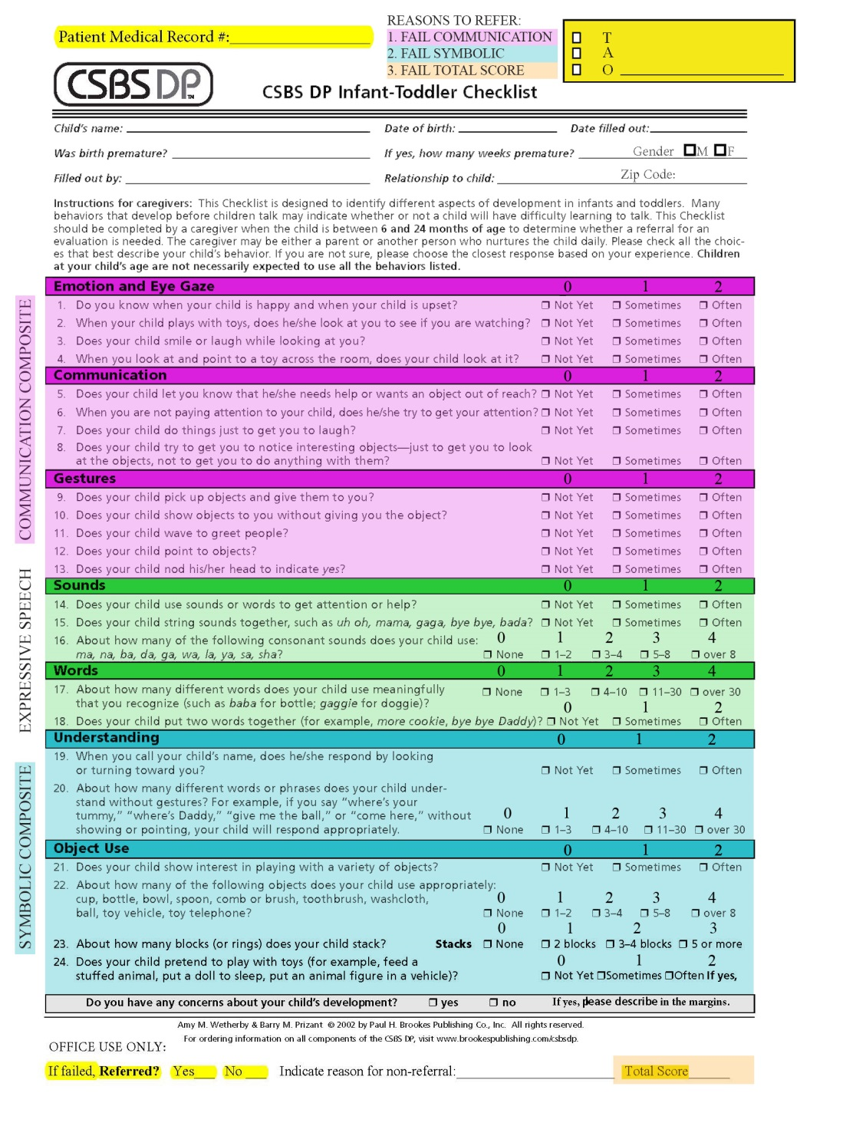
Notes/Considerations:
Medical Record is a requirement (for tracking)
Score each colored section separately, plus the total of all sections (Total Score)
Each age has separate scoring cut-offs (see next slide)
Three ways to fail- Communication, Symbolic, or Total Score
No need to refer for a failed Expressive Speech score alone, however feel free to refer any time there is a concern regarding development
Clinical Impressions box is for pediatrician’s impression of the child (T=typical, A= Autistic, O=Other). Please check a box.
Low scores are best discussed with the family by the pediatrician during the appointment
Fax failed CSBS forms for quicker service
So long as the coversheet is filled out to do so, we will contact parents of any child who fails or parents who check this is box and indicate a developmental concern we can address
If Ped prefers we do not call a family, please indicate that in reason for non-referral box (eg- Do not call). Otherwise we will call.

Slide 37
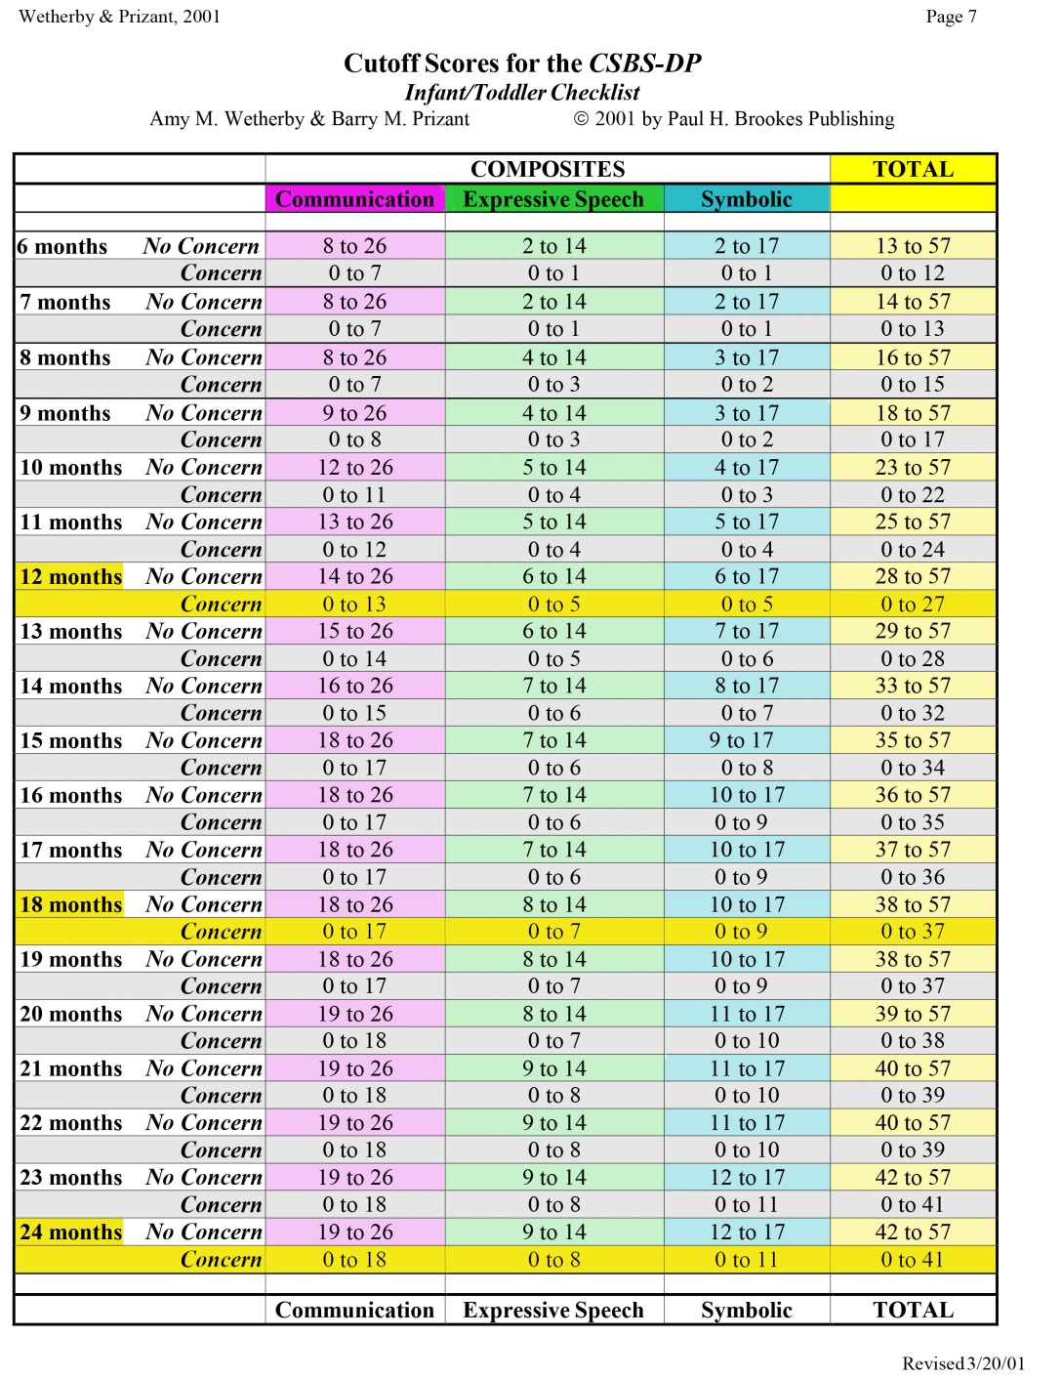
Notes/Considerations:
Each age has separate scoring cut-offs (see next slide)
Three ways to fail- Communication, Symbolic, or Total Score
Find completed age in months to find the cut-off scores for that age in each of the three categories and Total
(for a 12.5 month- old use the 12 month cut-off scores)
Again, no need to refer for a failed Expressive Speech score alone, however feel free to refer any time there is a concern regarding development
If baby scores in range of concern, please refer them to us for a free full developmental evaluation
If referral is made, please be sure to indicate by checking the box on the front
Triple Screen! 12 months, 18 months, and 24 month well-baby visits

Slide 38
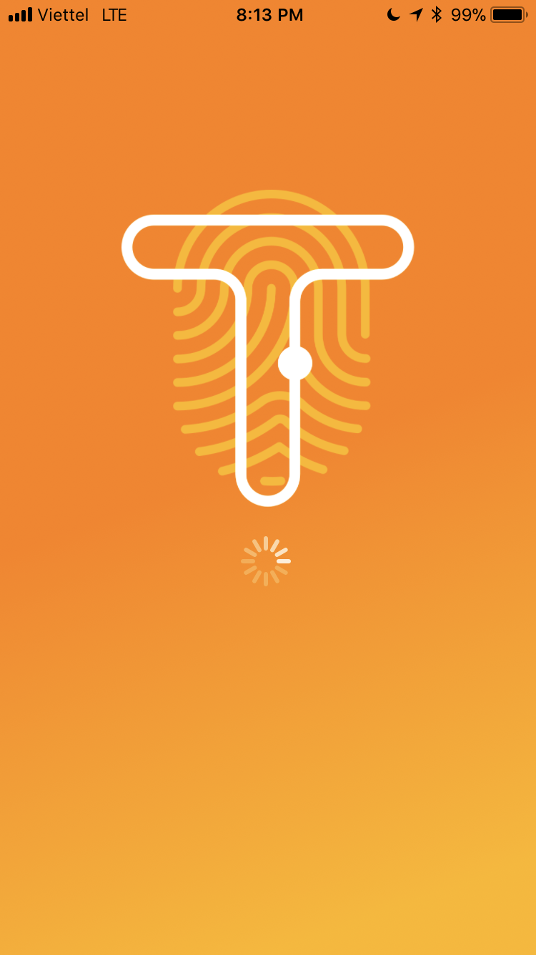
Trayt

Slide 39
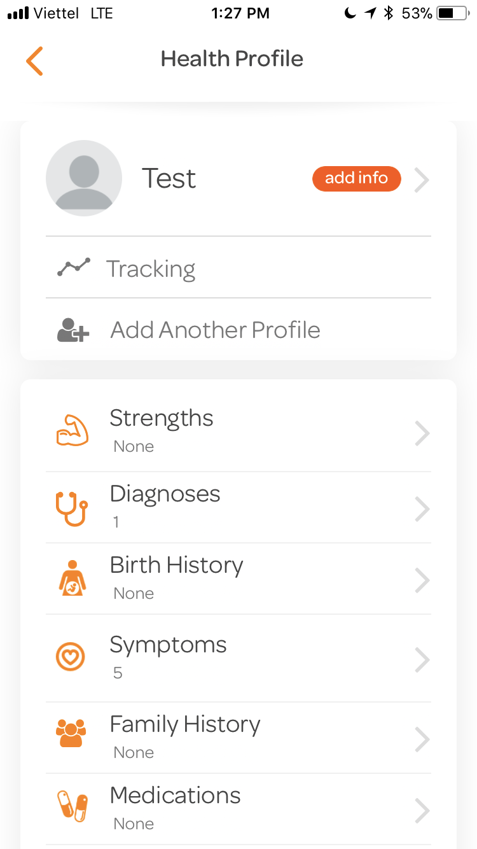

Slide 40
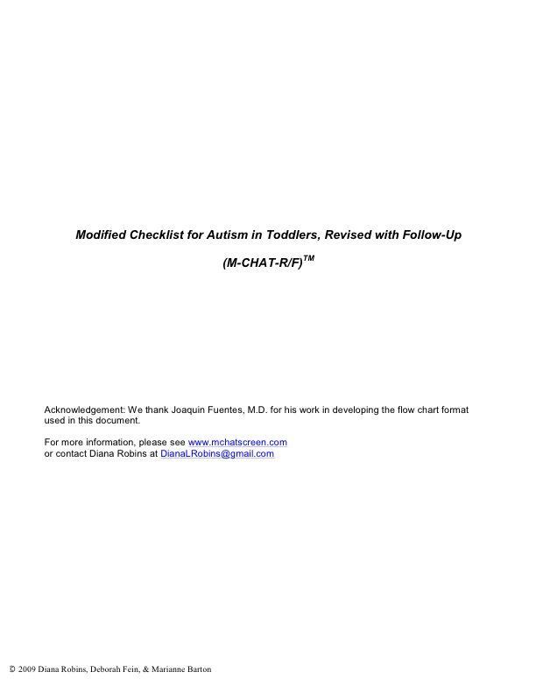
Toddler Screening Tool

Slide 41
Modified Checklist for Autism in Toddlers, Revised with Follow-Up (M-CHAT-R/F)TM
Acknowledgement: We thank Joaquin Fuentes, M.D. for his work in developing the flow chart format used in this document.
For more information, please see www.mchatscreen.com or contact Diana Robins at DianaLRobins@gmail.com
© 2009 Diana Robins, Deborah Fein, & Marianne Barton
Permissions for Use of the M-CHAT-R/FTM
The Modified Checklist for Autism in Toddlers, Revised with Follow-Up (M-CHAT-R/F; Robins, Fein, & Barton, 2009) is a 2-stage parent-report screening tool to assess risk for Autism Spectrum Disorder (ASD). The M-CHAT-R/F is available for free download for clinical, research, and educational purposes. Download of the M-CHAT-R/F and related material is authorized from www.mchatscreen.com.
The M-CHAT-R/F is a copyrighted instrument, and use of the M-CHAT-R/F must follow these guidelines: (1) Reprints/reproductions of the M-CHAT-R must include the copyright at the bottom ( 2009
Robins, Fein, & Barton). No modifications can be made to items, instructions, or item order
without permission from the authors.
(2) The M-CHAT-R must be used in its entirety. Evidence indicates that any subsets of items do not
demonstrate adequate psychometric properties.
(3) Parties interested in reproducing the M-CHAT-R/F in print (e.g., a book or journal article) or
electronically for use by others (e.g., as part of digital medical record or other software packages)
must contact Diana Robins to request permission (DianaLRobins@gmail.com).
(4) If you are part of a medical practice, and you want to incorporate the first stage M-CHAT-R
questions into your own practice’s electronic medical record (EMR), you are welcome to do so. However, if you ever want to distribute your EMR page outside of your practice, please contact Diana Robins to request a licensing agreement.
Instructions for Use
The M-CHAT-R can be administered and scored as part of a well-child care visit, and also can be used by specialists or other professionals to assess risk for ASD. The primary goal of the M-CHAT-R is to maximize sensitivity, meaning to detect as many cases of ASD as possible. Therefore, there is a high false positive rate, meaning that not all children who score at risk will be diagnosed with ASD. To address this, we have developed the Follow-Up questions (M-CHAT-R/F). Users should be aware that even with the Follow-Up, a significant number of the children who screen positive on the M-CHAT-R will not be diagnosed with ASD; however, these children are at high risk for other developmental disorders or delays, and therefore, evaluation is warranted for any child who screens positive. The M-CHAT-R can be scored in less than two minutes. Scoring instructions can be downloaded from http://www.mchatscreen.com. Associated documents will be available for download as well.
Scoring Algorithm
For all items except 2, 5, and 12, the response “NO” indicates ASD risk; for items 2, 5, and 12, “YES” indicates ASD risk. The following algorithm maximizes psychometric properties of the M-CHAT-R:
LOW-RISK: Total Score is 0-2; if child is younger than 24 months, screen again after second birthday. No further action required unless surveillance indicates risk for ASD.
MEDIUM-RISK: Total Score is 3-7; Administer the Follow-Up (second stage of M-CHAT-R/F) to get additional information about at-risk responses. If M-CHAT-R/F score remains at 2 or higher, the child has screened positive. Action required: refer child for diagnostic evaluation and eligibility evaluation for early intervention. If score on Follow-Up is 0-1, child has screened negative. No further action required unless surveillance indicates risk for ASD. Child should be rescreened at future well-child visits.
HIGH-RISK:
Total Score is 8-20; It is acceptable to bypass the Follow-Up and refer immediately for diagnostic evaluation and eligibility evaluation for early intervention.
© 2009 Diana Robins, Deborah Fein, & Marianne Barton
Childʼs name Date
Age Relationship to child
M-CHAT-RTM (Modified Checklist for Autism in Toddlers Revised)
Please answer these questions about your child. Keep in mind how your child usually behaves. If you have seen your child do the behavior a few times, but he or she does not usually do it, then please answer no. Please circle yes or no for every question. Thank you very much.
www.m-chat.org
1.
2.
3.
5.
7.
9.
If you point at something across the room, does your child look at it? (FOR EXAMPLE, if you point at a toy or an animal, does your child look at
Have you ever wondered if your child might be deaf?
Does your child play pretend or make-believe? (FOR EXAMPLE, pretend to from an empty cup, pretend to talk on a phone, or pretend to feed a doll or
Does your child make unusual finger movements near his or her eyes? (FOR EXAMPLE, does your child wiggle his or her fingers close to his or her
Does your child point with one finger to show you something interesting? (FOR EXAMPLE, pointing to an airplane in the sky or a big truck in the road)
the toy or animal?)
drink
stuffed animal?)
eyes?)
Yes No
Yes No
Yes No
Yes No
Yes No
Yes No
Yes No Yes No Yes No
Yes No
Yes No
4. Does your child like climbing on things? (FOR EXAMPLE, furniture, playground Yes No equipment, or stairs)
6. Does your child point with one finger to ask for something or to get help? Yes No (FOR EXAMPLE, pointing to a snack or toy that is out of reach)
8. Is your child interested in other children? (FOR EXAMPLE, does your child watch Yes No
other children, smile at them, or go to them?)
Does your child show you things by bringing them to you or holding them up for you to see – not to get help, but just to share? (FOR EXAMPLE, showing you a flower, a stuffed animal, or a toy truck)
10. Does your child respond when you call his or her name? (FOR EXAMPLE, does he or she Yes No look up, talk or babble, or stop what he or she is doing when you call his or her name?)
11. When you smile at your child, does he or she smile back at you?
13. Does your child walk?
15. Does your child try to copy what you do? (FOR EXAMPLE, wave bye-bye, clap, or make a funny noise when you do)
17. Does your child try to get you to watch him or her? (FOR EXAMPLE, does your child look at you for praise, or say “look” or “watch me”?)
19. If something new happens, does your child look at your face to see how you feel about it? (FOR EXAMPLE, if he or she hears a strange or funny noise, or sees a new toy, will
he or she look at your face?)
12. Does your child get upset by everyday noises? (FOR EXAMPLE, does your Yes No child scream or cry to noise such as a vacuum cleaner or loud music?)
14. Does your child look you in the eye when you are talking to him or her, playing with him Yes No
or her, or dressing him or her?
16. If you turn your head to look at something, does your child look around to see what you Yes No are looking at?
18. Does your child understand when you tell him or her to do something? Yes No (FOR EXAMPLE, if you don’t point, can your child understand “put the book
on the chair” or “bring me the blanket”?)
20. Does your child like movement activities? Yes No (FOR EXAMPLE, being swung or bounced on your knee)
© 2009 Diana Robins, Deborah Fein, & Marianne Barton

