Slide 1
HIV AIDS, SUD and mHealth
A Selective Review of emerging technologies

Slide 2

Ronald R Odonnell, Phd
Ronald.odonnell@asu.edu
https://chs.asu.edu/onlinehealthprograms
QQ: 204806
Whatsapp: ron odonnell
Skype: ronald.r.odonnell
Web: www.chs.asu.edu
Web: www.suncranehealth.com
www.linkedin.com/in/ronodonnellasudbh

Slide 3


Slide 4


Slide 5
Learning objectives
Define the importance of mHealth in prevention and management of HIV/aids, substance use disorder (SUD)
Describe examples of mheath strategies and techniques
Describe a systems approach to mhealth for hiv/aids and sud

Slide 6
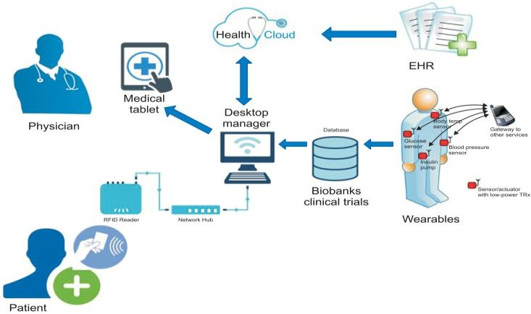
mHealth = Improved behavioral health + HIV/AIDS prevention and management

Slide 7
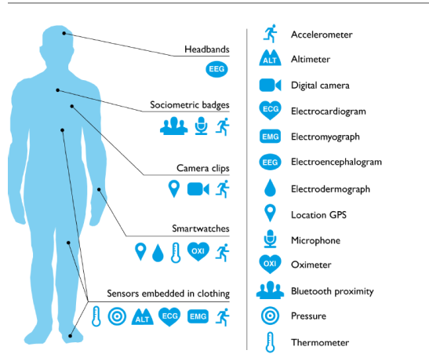
Wearable biometric sensors

Slide 8
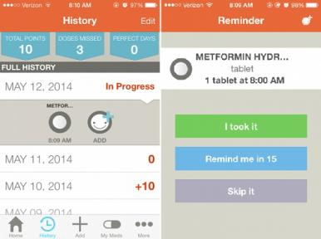
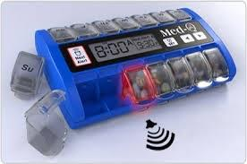
Medication adherence

Slide 9
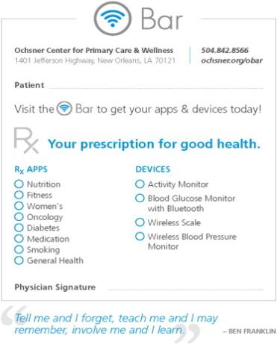
The Behavioral Health Technology Prescription Pad

Slide 10
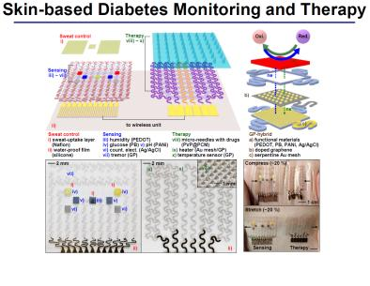
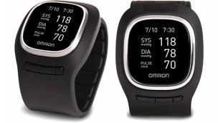
Blood pressure (wrist activity tracker)
Blood sugar (electrochemical glucose sensor)

Slide 11
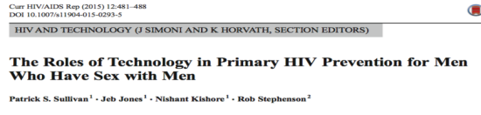
Technology-based primary HIV prevention tools for MSM
Provision of information | Basic information on HIV risks, prevention and management practices | www.healthmpowerment.org www.AIDSVu.org
Self-assessment | questions to determine whether a certain prevention service might be right for them | www.findyourfrequency.com is a browser-based utility to determine recommended HIV testing frequency.
Reminders of recurring services | Provide SMS-based, email-based, reminder calls, or native mobile OS notifications to promote recurring services (e.g., HIV testing ) | HealthMindr allows men to schedule a regular HIV testing interval and then select how they will receive reminders when a followup test is due

Slide 12
Offering prevention commodities | Websites or mobile apps can offer prevention commodities (e.g., condoms, | HealthMindr offers distribution of free condoms and HIV self-test kits by mail
Adherence reminders | Provide SMS-based, email-based, reminder calls, or native mobile OS notifications to promote medication adherence | PrEP demonstration projects have utilized texting, mobile apps, and websites to provide adherence education or counseling
Delivering prevention interventions | Behavioral interventions can be delivered through web-based or app-based activities, typically through theory-based activities to strengthen self-efficacy | www.healthmpowerment.org is a browser and mobile-phone based intervention to increase self-efficacy, skills and abilities and change
Referrals to services | Providing information about where men can access specific prevention services | GetConnected is a HIV/STI education site and testing locator.

Slide 13
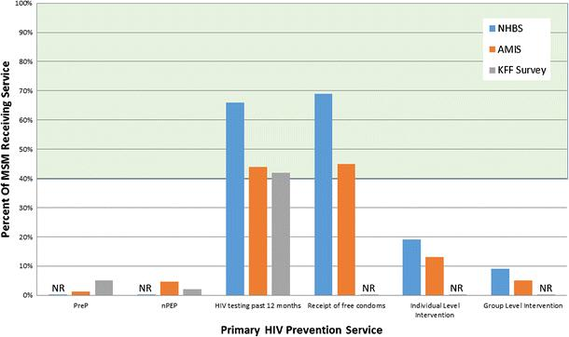
Estimated coverage of primary HIV prevention interventions among men who have sex with men in the USA and estimated levels of coverage required to reduce HIV incidence, 2010–2015. NHBS National HIV Behavioral Surveillance

Slide 14
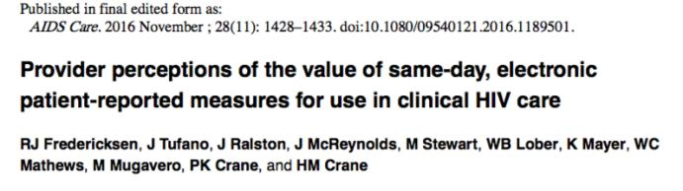
Benefits and Challenges of Patient Reported outcomes (PRO’s)
Helps set agenda for clinic visit
Identifies less-observable and difficult-to-discuss behaviors and conditions
initial concerns regarding impact on clinic flow
Interpretation of Result

Slide 15
Problem of Men who have Sex with Men (MSM)
Despite advances in HIV diagnostics, treatment, and behavioral interventions to increase medication adherence, youth and young adults continue to have low rates of care linkage and retention.
Despite advances in HIV diagnostics, treatment, and behavioral interventions to increase medication adherence, youth and young adults continue to have low rates of care linkage and retention.
MSM of all races/ethnicities and age groups continue to be disproportionately affected by HIV, accounting for nearly two-thirds of all new infections in the US (CDC, 2013)

Slide 16
Youth and young MSm and smartphones
Young MSM have high rates of social media use, including Facebook, text messaging, and GPS-based mobile applications (“apps”) designed for social and sexual networking (e.g., Adam4Adam (A4A)/Radar, badoo, Grindr, Jack’d, and SCRUFF)
rates of social media use are largely related to increased access to smartphones and other mobile devices (Sun, et al., 2015). In a recent study of MSM, 72% owned a smartphone or other mobile device and an additional 9% planned to buy one in the next year (Grov, et al., 2013).

Slide 17
Greater smartphone app use greater risk
app users tend to have:
lower HIV testing rates
higher numbers of sexual partners;
more likely to report: sex with both men and women
alcohol and drug use during
unprotected anal intercourse sexually transmitted infection (STI) history

Slide 18
HIV Care Continuum
HIV Care Continuum:
identifies HIV testing, care linkage, initiation of ART, and care retention of young MSM as public health priorities
Missed opportunities for linkage and engagement across the Continuum opportunties for MSM to disengage
Failures in HIV Care Continuum associated with lower levels of viral suppression and greater likelihood of HIV transmission and viral resistance

Slide 19
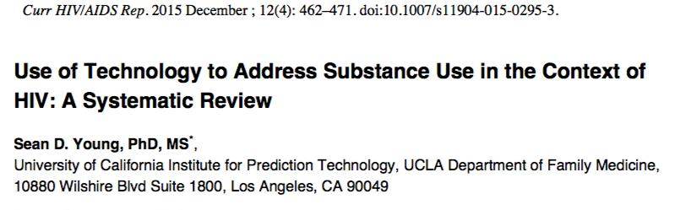

Slide 20
Use of technology to address sud and hiv
U.S. 40% of individuals living with HIV disclosed they used illegal drugs in the past year
High risk populations: MSM and substance users
MSM are disproportionately at risk for contracting HIV
A study examining over 550 million tweets found that people are also discussing their substance use in tweets, and that analyzing these trends and patterns of “social big data” can be used to monitor and predict HIV incidence

Slide 21
Use of technology to address sud and hiv
technology use as a vehicle to engage in HIV risk behaviors.
social media sites, apps and SMS text messaging used to both facilitate as well as prevent HIV transmission.
example: smartphone apps for MSM social networking targeted facilitate finding sexual partners online.
62.1% of users use apps to find one-on-one sex,
17.1% used the app to find group sex, and
46.1% reported having unprotected anal intercourse in the past 3 months

Slide 22
technology can also serve to prevent HIV transmission.
Harnessing Online Peer Education (HOPE) social media-based intervention, participants were more likely to request an HIV self-testing kit if they were a member of a HOPE intervention group
text messages can decrease HIV risk behaviors among substance-using MSM

Slide 23
Technologies have tremendous potential to address HIV risk among substance users
increase Research recruitment by reaching potential participants through online website advertisements, social media sites, smartphone apps, email, and text messages.
can be tailored to individual characteristics, personalized health intervention rather than targeting a large group
can reach large audiences in cost-effective ways (Seth, Hulda & Larson, 2009), they could be used in reducing HIV transmission among populations at risk, including substance users

Slide 24
Examples of health technologies for hiv/aids/sud

Slide 25
“HealthCall” interactive voice response (IVR), apps, to support motivational interviewing (MI) to reduce substance use in HIV primary care
daily IVR self- monitoring of substance use and goal settings (and mood, medication adherence, and quality of life)
brief 1-3 minute surveys, tailored feedback response data visualized in time trend graphs
feedback ued by MI counselors at 30-day follow-up evaluations.
results found greater impact on number of drinking days for MI plus HealthCall compared to MI only and to education only control, with greater effects for alcohol dependent patients compared to non-dependent alcohol users

Slide 26
Healthcall
Benefits greatest for patients with lower motivation, more ambivalence,
daily self-monitoring enhances intervention for most resistant to change
app version of HealthCall found similar effect but more than 20% greater patient engagement (85% daily participation rates vs. 65%) and high patient satisfaction
note, at 12-month follow-up, the trends in effects were similar but had waned and lost statistical significance

Slide 27
healthcall
brief in-person interventions through self-monitoring. Etechnology for self-monitoring and feedback is scalable and sustainable with relatively low costs compared to follow up counseling sessions
self-monitoring as a self-directed intervention strategy for people living with HIV aids sud

Slide 28
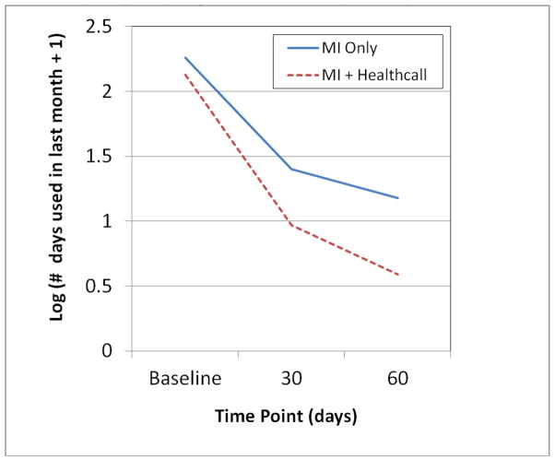

Slide 29
“Project Tech Support” tech and provider-mediated interventions for sud and HIV
a text-messaging intervention to reduce substancee use and high-risk sexual behaviors with out-of- treatment MSM
messaging content was delivered several times each day by peer health educators
Pilot study Results:
up to four text-message conversations per day consisting of up to 20 text-messages each way per conversation)
significant reductions in methamphetamine use and sexual risk behaviors at two-month follow up evaluations
based on the Health Belief Model targeting risk perceptions, and Social Cognitive Theory targeting self-efficacy
Reback CJ, Fletcher JB, Shoptaw S, Mansergh G. Exposure to Theory-driven Text Messages is Associated with HIV Risk Reduction among Methamphetamine-using Men who have Sex with Men. AIDS & Behavior. 2015; 19:S130–S141.

Slide 30
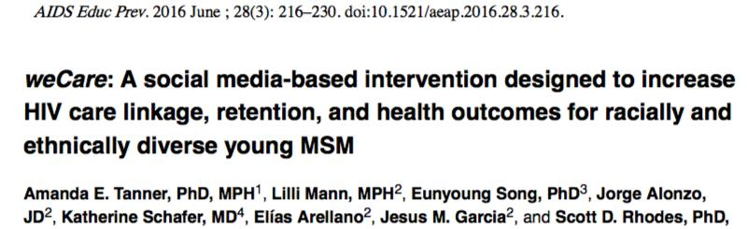


Slide 31
WeCare Intervention overview
tailored intervention that uses established social media platforms used my msm
tailored to the social media preferences of each participant, since there may be variations in use of different social media platforms.
weCare Health Educator will use a combination of Facebook messenger, text messaging, and app-based instant messages, based on the participants’ preferences, to communicate with each participant individually using theory- based messages specific to each participant’s place on the Continuum

Slide 32
Overview of WeCare intervention strategies
Overview of weCare intervention strategies for moving young MSM across the Continuum
Stage along the Continuum | Diagnosis | Care linkage | Care Retention | ART Rx | Viral Suppression
Example Health Educator Strategies | Meet (in person), build trust and rapport, determine social media preferences | Provide reminders; de-mystify clinic processes; problem solve to reduce barriers; applaud positive behaviors, via preferred social media | Explore why appointment was missed; problem solve to reduce barriers; provide appointment reminders; applaud positive behaviors; check-in; offer social support, via preferred social media | Provide prescription fill reminders; problem solve to reduce barriers; applaud positive behaviors, via preferred social media | Provide reminders to take medications; problem solve to reduce barriers; applaud positive behaviors, via preferred social media

Slide 33
Wecare
targeted for diverse MSM
use existing social media platforms, to meet MSM “where they are”
use evidence-based strategies and messages to promote health
weCare Health Educator will communicates at the pace of each user - building trust, discussing priorities related to care, providing social support, ideas to overcome barriers to care
Health Educator’s is a community insider
transparency about the Health Educator’s identity and role will help to establish credibility.

Slide 34
Wecare
Intervention is tailored by media used
Majority of young MSM are willing to use Facebook, text messaging, and app-based instant messaging to receive sexual health information
MSM can choose their mode of connection to the health educator (e.g., separate or combined the use of Facebook, text messages, app, , and Facebook
led to e high retention rates For example, using these 3 platforms, we had a 100% retention rate at 6-month follow-up in one study a 95% retention rate at 24-month follow-up in another

Slide 35
Wecare tailored to each participant’s needs
Tailored to individual icare linkage, medication reminders, social support, education
based on his specific needs and context (e.g., age, developmental)
Health Educators tailor theory-based messages to specific needs
Focuses on the Health Educator’s ability to identify with, build trust, engage in dialogue, and offer appropriate and personalized guidance to social media users.

Slide 36
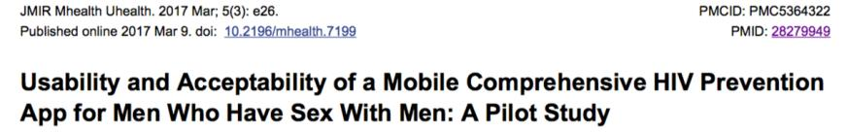
pp included self-assessment tools; prevention recommendations; commodity (condoms, HIV self- tests) ordering; reminders to MSM for basic HIV prevention services, HIV testing, condom use, screening for preexposure prophylaxis (PrEP) and nonoccupational postexposure prophylaxis (nPEP); and prevention and treatment provider locators
For those who are HIV-negative, biomedical interventions such as preexposure prophylaxis (PrEP) hold promise to reduce susceptibility to HIV [1-3].

Slide 37
app content was developed based on the social cognitive theory of behavior [25]. Briefly, the app features enumerated in the following section were developed to fit into a framework of several health outcome behaviors (eg, making a plan to test regularly for HIV, using condoms, self-screening for PrEP, seeking HIV care for those living with HIV). For each health or prevention behavior, there were specific app features that were designed to promote goal setting, self-efficacy, outcome expectations, and self- regulation. For example, for the behaviors of HIV testing, the “Make a plan” app feature promoted goal setting, the presentation of several testing options and information promoted self-efficacy, information about the benefits of testing promoted positive outcome expectations, and a customizable reminder system for testing promoted self-regulation

Slide 38
App Features
features included monthly risk assessment quizzes that offered tailored HIV-prevention related recommendations, quizzes to self-assess PrEP and nonoccupational postexposure prophylaxis (nPEP) eligibility, resources to create and schedule a custom HIV testing plan with reminders, a global positioning system (GPS) enabled map of HIV testing locations with their operational details, and ordering of free condoms and at-home HIV test kits.

Slide 39
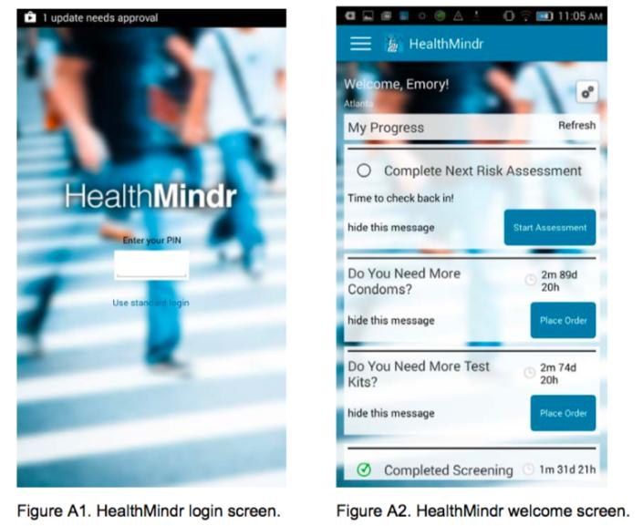

Slide 40
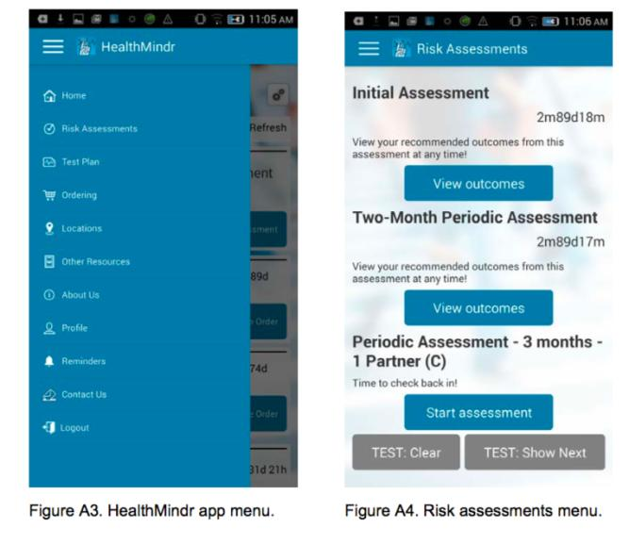

Slide 41
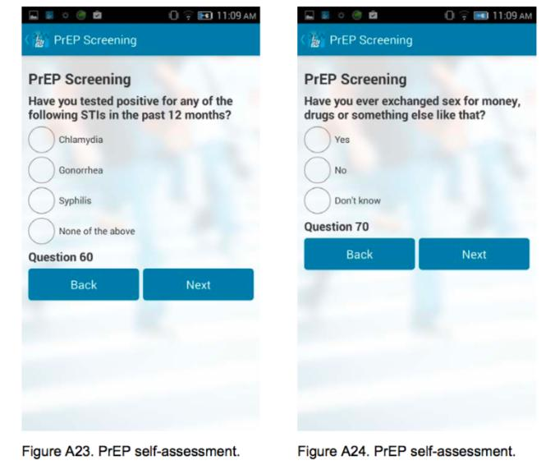

Slide 42
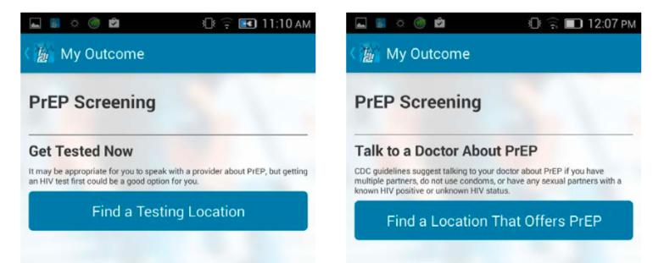

Slide 43
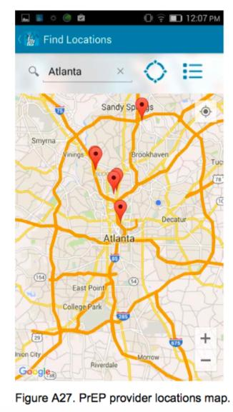
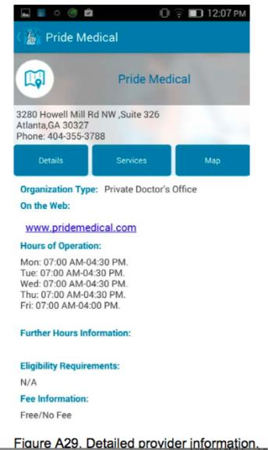

Slide 44
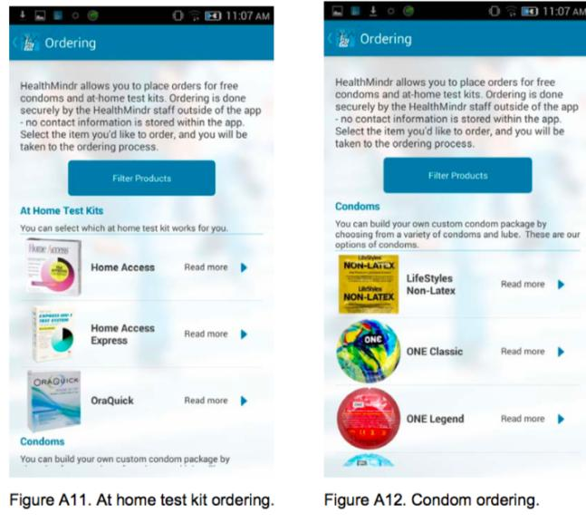

Slide 45
Results
Over the 4-month period, over half ordered condoms (63.6%, 77/121) and HIV test kits (52.8%, 64/121) on the app. Eight of 86 (9%) PrEP-eligible MSM started PrEP during the 4-month period; of those, 6 of the 8 reported that the app influenced their decision to start PrEP. The mean SUS was 73 (above average).
App Evaluation
88% finding the level of detail and 81% finding the assessment recommendations to be useful or very useful.
66% felt the app content helped them to stick to an HIV prevention plan.
Most participants felt the app was a good balance of personal and professional language (71%) and the information was easy to understand (90%). M
ost participants felt confident in app security (86%), including a password or PIN offering sufficient protection (85%) and the app name and icon not readily associated as an HIV prevention app (84%).

Slide 46
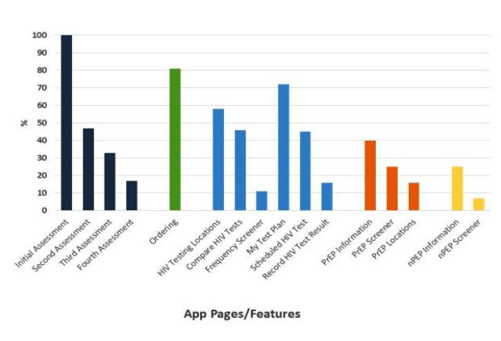
Percent of MSM participants that used features or viewed pages in the app during a 4-month pilot study, United States, 2015 (n=109). MSM: men who have sex with men.

Slide 47
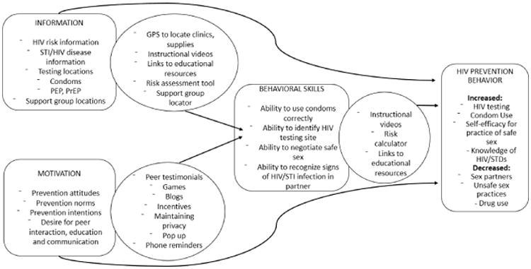
IMB model for HIV prevention, detailing the HIV prevention information/motivation via app

Slide 48
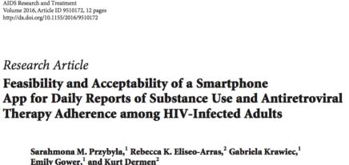
DRUM (Daily Reports of Using Medications)
completed 95.3% of time-based daily reports.
high satisfaction with the app
interest in using smartphones to report daily behaviors.
suggest that smartphones are a feasible, acceptable method for collecting substance use and ART data among PLH.

Slide 49
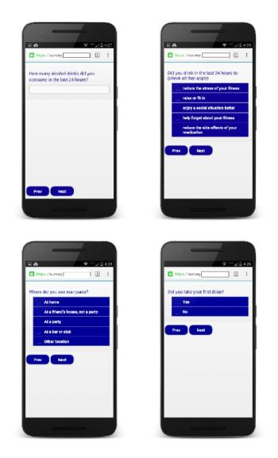
DRUMM app
text-prompted to respond, given a 2-hour window to access the DRUM app and complete the daily report (i.e., time-based reporting)
If participants failed to complete a report by 6 pm, they had the ability to access the DRUM app and complete a make-up report the following day.

Slide 50
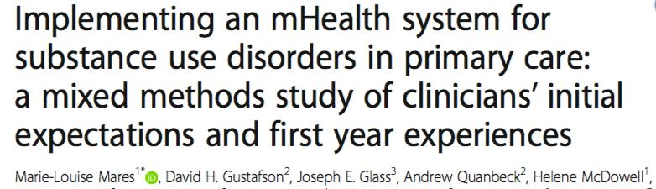


Slide 51
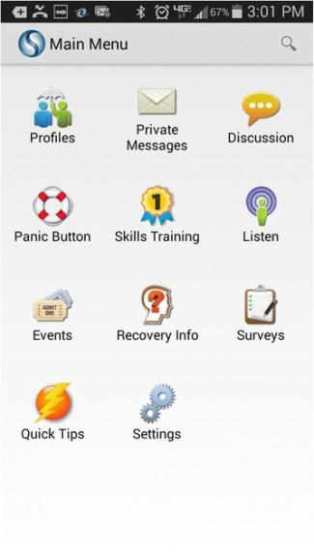
SEVA
Seva (from the Sanskrit for “selfless caring”) is an mHealth system designed to support care for patients with sub- stance use disorders
A-CHESS resources on the phone include health tracking, a discus- sion board populated by patients in the study, and tools for coping with cravings and high-risk situations (e.g., relax- ation exercises and links to local Twelve Step meetings)
TESS: 65 interactive modules designed to teach problem solving, self-regulation, coping, and lifestyle restructuring skills

Slide 52
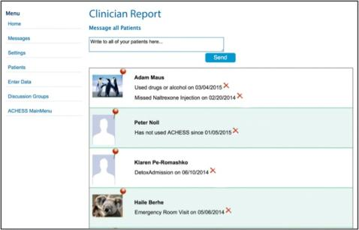
SEVA
web portal “Clinician Report” containing data generated by patients’ use of Seva (e.g., weekly health-tracking surveys, including reports of relapses).
Clinicians visiting the portal see a graph of participating patients’ scores over time

Slide 53
Results
One year later at Site 1, behavioral health care providers, rather than physicians, had incorporated Seva into patient care, primarily by discussing it during appointments. Given workflow/load concerns, only a few key clinicians monitored health tracking/relapses and prompted outreach when needed; two researchers monitored the discussion board and alerted the clinic as needed. Clinician turnover/leave complicated this approach. Contrary to clinicians’ initial concerns, patients showed sustained, mutually supportive use of Seva, with few instances of misuse.

Slide 54
Summary and discussion

