Slide 1

Management of Suicide among Persons with Addictive Disorders
Yatan Pal Singh Balhara
Associate Professor of Psychiatry
Department of Psychiatry and National Drug Dependence Treatment Centre (NDDTC)
All India Institute of Medical Sciences (AIIMS), New Delhi, INDIA

Slide 2
Outline of this presentation

Slide 3
Poll Question 1

Slide 4
What is suicidal behavior?
Suicidal thoughts
Suicidal planning
Suicidal attempts (unsuccessful)
Serious suicide attempt
Completed suicide
Either 1 or 2 or 3 or 5
Either 1 or 2 or 3 or 4 or 5
Either 4 or 5

Slide 5
Suicide- terms

Slide 6
SUICIDE
Death caused by self-directed injurious behavior with an intent to die as a result of the behavior

Slide 7
SUICIDE ATTEMPT
A non-fatal, self-directed, potentially injurious behavior with an intent to die as a result of the behavior; might not result in injury

Slide 8
SUICIDAL IDEATION
Thinking about, considering, or planning suicide

Slide 9
SERIOUS SUICIDE ATTEMPT
actual lethality (report of medical assistance after the attempt, regardless of the mean that was used)
or
potential lethality (use of a mean other than superficial cutting or self-intoxication, regardless of further medical assistance)

Slide 10
SUICIDAL BEHAVIOR
SUICIDE
SUICIDAL IDEATION
SUICIDE ATTEMPT
SERIOUS SUICIDE ATTEMPT

Slide 11
Related terms
DELIBERATE SELF HARM
NON SUICIDAL SELF INJURY (NSSI)

Slide 12
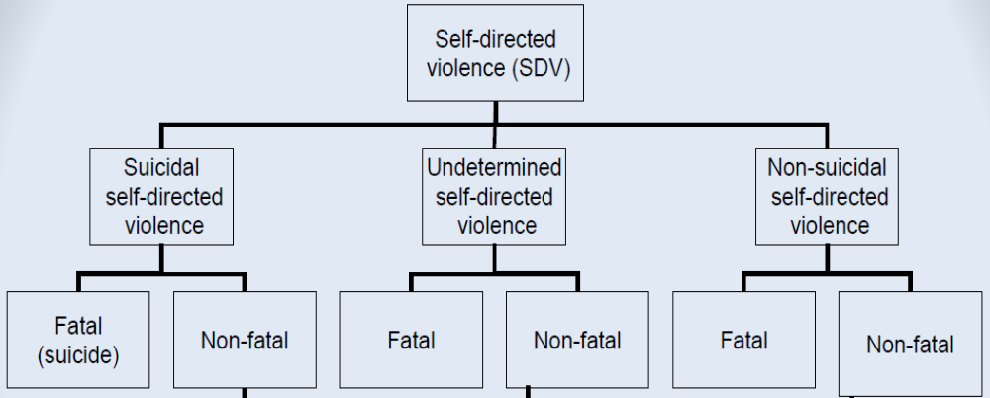
(Source: https://www.mirecc.va.gov/visn19/docs/presentations/SDVCS_Master_Training.pdf)

Slide 13
Poll Question 2

Slide 14
Which of these statements is TRUE?
Suicide is the 13th leading cause of Years of Life Lost (YLL) worldwide
Nearly 1 million people complete suicide each year
More than 80% of suicides occur in the low and middle income countries
None of these
All of these

Slide 15
Suicide is the 13th leading cause of Years of Life Lost (YLL) worldwide
Nearly 1 million people complete suicide each year
More than 80% of suicides occur in the low and middle income countries

Slide 16
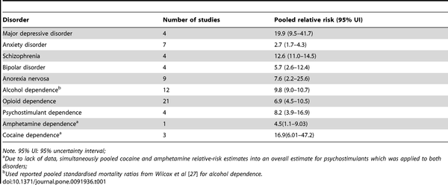

Pooled relative-risk of suicide in those diagnosed with mental or substance use disorder
Ferrari AJ, Norman RE, Freedman G, Baxter AJ, Pirkis JE, et al. (2014) The Burden Attributable to Mental and Substance Use Disorders as Risk Factors for Suicide: Findings from the Global Burden of Disease Study 2010. PLOS ONE 9(4): e91936. https://doi.org/10.1371/journal.pone.0091936
http://journals.plos.org/plosone/article?id=10.1371/journal.pone.0091936

Slide 17
Why persons with addictive disorders are at increased risk?

Slide 18
Shared risk factors
ADDICTIVE DISORDERS
SUICIDE
IMPULSIVITY
GENETIC FACTORS

Slide 19
Substances as predisposing factors
Adverse life events
Impaired problem solving
Poor support system
ADDICTIVE DISORDERS
SUICIDE

Slide 20
Mediating effect of mental disorders
MENTAL DISORDERS
ADDICTIVE DISORDERS
SUICIDE

Slide 21
Substances as proximal risk factors
Disinhibition
Aggression
Impaired judgement
Increased lethality of medicines

Slide 22
Why persons with addictive disorders are at increased risk?
Shared risk factors
Predisposing factors
Mental disorders
Proximal risk factors

Slide 23
MANAGEMENT

Slide 24
Poll Question 3

Slide 25
How difficult is suicide management on a scale of 1- 10, where 1 is not difficult and
10 is most difficult?

Slide 26
Be Aware

Slide 27
Be aware
Persons with addictive disorders are at increased risk of suicide
Suicidal behaviour can be exhibited at any point in time
Risk for suicidal behavior can be increase even among those in treatment

Slide 28
Look for risk factors

Slide 29
Risk factors
Prior history of suicide attempts- most potent risk factor

Slide 30
Risk factors
Severe substance use (dependence on multiple substances, early onset of dependence)
Co-occurring mental disorder

Slide 31
Risk factors
Family history of suicide
History of childhood abuse (especially sexual abuse).

Slide 32
Risk factors
Stressful life circumstances
Personality traits

Slide 33
Risk factors
Suicidal thoughts/ plans and access to means to attempt suicide

Slide 34
Those without any of the risk factors can also attempt suicide

Slide 35
Build up PROTECTIVE factors

Slide 36
Build up PROTECTIVE factors
Having reasons for living
Being abstinent
Good psycho- social support system

Slide 37
Poll Question 4

Slide 38
Persons who talk about or threaten suicide don’t attempt it
True
False

Slide 39
Pick up WARNING Signs

Slide 40
Pick up WARNING Signs- Direct
Suicidal communication
Seeking access to method
Making preparations

Slide 41
Pick up WARNING Signs- Indirect
Suicidal ideation
Sense of purposelessness
Feelings of hopelessness
Withdrawn to self
Reckless behaviour
Mood changes
Stressful life event

Slide 42
Poll Question 5

Slide 43
Discussing about suicide might give one the idea or upset them enough to "push them over the edge."
It is best to ignore it.
True
False

Slide 44
Gather information
Access supervision
Take responsible action
Extend the action
(SAMHSA)

Slide 45
Gather information- Screening questions
Introducing the topic
  I have a few questions to ask you about suicidal thoughts and behaviors.
Screening for suicidal thoughts
  Have you thought about killing yourself?
Screening for suicide attempts
  Have you ever tried to take your own life?
(SAMHSA)

Slide 46
Gather information- Follow up questions
Sample follow up questions about suicidal thoughts:
  Can you tell me about the suicidal thoughts?
    For example, What brings them on?
    How strong are they?
    How long do they last?
  Have you made a plan? (If yes) What is your plan?
  Do you have access to a method of suicide? A gun? An overdose?
  Do you intend to attempt suicide?
(SAMHSA)

Slide 47
Gather information- Follow up questions
Sample follow up questions about suicide attempts:
  Please tell me about the attempt.
    For example, What brought it on? Where were you? Were you drinking or high?
  To gather information about lethality:
    What method did you use to try to kill yourself?
    Did you receive emergency medical treatment?
  To gather information about intent:
    Did you want to die? How much?
    Afterward, were you relieved you survived, or would you rather have died?
(SAMHSA)

Slide 48
Access supervision
Someone with advanced mental health degree and specialized training in suicide risk management

Slide 49
Take responsible action
Judgment about the seriousness of risk
Take actions accordingly

Slide 50
Take responsible action
Gather additional information from the client
Gather additional information from other sources
Arrange an appropriate referral

Slide 51
Take responsible action
Restrict access to means of suicide.
Temporarily increase the frequency of care
Temporarily increase the level of care
Involve a case manager
Involve the primary care provider

Slide 52
Take responsible action
Encourage the client to attend (or increase attendance) at self help groups 12-Step meetings
Enlist family members or significant others in observing indications of a return of suicide risk.
Observe the client for signs of a return of risk

Slide 53
Take responsible action
Create a safety card with the client in the event of a return of acute suicidality.
Create a detailed safety plan with the client in the event of relapse to alcohol or drugs.
Give the client an emergency hotline number.
Invite the client to contact you (or an emergency hotline) in the event of acute suicidality.

Slide 54
Extend the action
Persons at increased suicide risk experience a return of suicide risk

Slide 55
Extend the action
Confirm that a client has kept the referral appointment with a mental health professional
Follow up with the hospital emergency department
Coordinate with a mental health professional on an ongoing basis.
Coordinate with a case manager on an ongoing basis.

Slide 56
Extend the action
Check in with the client about any recurrence of or change in suicidal thoughts or attempts.
Check in with family members about any recurrence of or change in suicidal thoughts or attempts.
Observe the client for signs of a return of risk.

Slide 57
Extend the action
Confirm that the client still has a safety plan in the event of a return of suicidality.
Confirm that the client and still have an emergency phone number.
Confirm that the client still does not have access to a major method of suicide.

Slide 58
Docuemntation

Slide 59
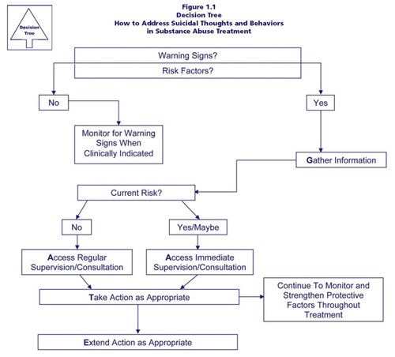

Slide 60
Conclusions
Risk of suicidal behaviour is higher among persons with addictive disorders
Always screen for risk factors
Always look out for suicidal behaviour
Be prepared and proactive
SUICIDE IS PREVENTABLE

Slide 61
Thank you
ypsbalhara@gmail.com

