Slide 1
Joint Vietnam United States Education and Training Proposal
Ronald R. O’Donnell, Ph.D.
Clinical Professor
Arizona State University
President, SunCrane Health Solutions

Slide 2

Ronald R. O’Donnell, Ph.D
Ronald.odonnell@asu.edu
QQ: 204806
WeChat: ronodonnell
Skype: ronald.r.odonnell
Web: www.chs.asu.edu/dbh
Web: www.suncranehealth.com

Slide 3
The Business Case for Integrated Behavioral Health

Slide 4
The Problem
Non-communicable disease (NCD) increasing in Vietnam
Lifestyle behaviors lead to NCD onset, morbidity and mortality
Behavioral conditions such as depression are untreated
Physicians rely on medications that do not address lifestyle behaviors
Workforce to deliver evidence based interventions lacking
Patients dissatisfied, physicians under stress and facing burnout

Slide 5

Medical Conditions don’t exist in a Silo
Chronic disease (diabetes, etc.)
Depression, Anxiety, Trauma
Alcohol and substance abuse
Risky sexual behavior
Serious Mental Illness

Slide 6

The Economic Burden of Chronic Behavioral and Medical Illness
10% of patients use 65% of resources
Medical + Behavioral Conditions 2X Cost compared to Medical only
Notes:
行为和医学上的慢性病问题成为经济负担
在2000年，有超过1.25亿的人最少有一种慢性病， 预测在2020年将有1.57亿。
在此人群中有超过50%的人有多于一种慢性病

Slide 7
Risk Factors for NCD in Vietnam
Obesity prevalence increasing (e.g., 15% of men and women obese) (Ho-Pham et. al, 2015)
Hypertension is common, but people are not aware of diagnosis
Tobacco and alcohol use among men high, and tobacco use may be increasing in women (Hoy et. al, 2013)

Slide 8

Risk Factors for NCD in Vietnam
High percentage of diets do not meet criteria for fruit and vegetable intake
Low levels of physical activity (Hoy et. al, 2013)

Slide 9
Direct and Indirect Costs of Smoking in Vietnam (Hoang Anh et. al, 2014)
2011 total economic cost of smoking 26679.9 billion VND (.97 of GDP)
Direct costs of inpatient and outpatient care reached 9869.2 billion and 2567.2 billion VND, respectively
Government contribution was 4534.3 billion VND = 5.76 of total health budget
Indirect costs lost productivity was 12216.4 VND, about 50% of total costs

Slide 10
Multi-morbidity in Vietnam Elderly
Increased life-expectancy. Elderly:
  9% in 2009
  16% in 2029
  26% in 2049
Nearly 40% of elderly multi-morbid chronic conditions
High burden of multi-morbidity among illiterate living in rural areas

Slide 11
Depression, Anxiety and Stress Symptoms in Vietnam

Slide 12
Depression: Diagnosis and Treatment in Vietnam (Niemi et. al, 2013)
Depression one most common behavioral conditions in primary care
Expressed as somatic complaints (insomnia, headache, dizziness, gastric complaints, general aches and pains)
Often seek care from Traditional Vietnamese Medicine (TVM), witchcraft, spiritual blessing and ritual

Slide 13
Depression: Diagnosis and Treatment in Vietnam (Niemi et. al, 2013)
Depression reflects chronic social adversity: in-law problems, marital, job insecurity and financial problems
Western psychotherapy focused on exploration of private emotions and experiences may not fit with Confucian, sociocentric view
Meditation practices such as mindfulness for depression may be better fit

Slide 14
Collaborative Care for Depression in Vietnam (Ngo et. al, 2014): RESULTS
Western depression care program in low-resource, non-Western Vietnam
PHQ-9 under-diagnosed depression
Low patient acceptance and high dropout
Provider resistance to program
Treatment drained resources (e.g., 45 minute sessions, frequent follow-up)
Provider resistance to task-shifting (training non-specialists to provide care)

Slide 15
Collaborative Care for Depression in Vietnam (Ngo et. al, 2014): ADAPTATIONS
Community-wide education campaign
Increased input from providers
Enhanced supervision
Workshops on collaborative care
Inter-professional relationship-building, leadership to advance multi-level healthcare approach

Slide 16

Integrated Behavioral Health

Slide 17
Definition: Integrated Behavioral Health
Add expert behavioral health clinician into hospital and community health centers to treat;
Behavioral risk factors for non-communicable disease (smoking, lack of physical activity, poor nutrition), and;
Behavioral disorders (depression, anxiety, somatic/stress symptoms)

Slide 18
Behavioral Health Consultant Treats Multiple Health Problems
Medical
Diabetes
CHD
Behavioral
Depression
Anxiety
Lifestyle
Overeating
Alcohol abuse
Poor nutrition
Lack of physical activity

Slide 19
The Patient-Centered Medical Home Impact on Cost and Quality PCPCC 2015
Annual Review of Evidence 2013-14
28 peer reviewed studies, State government program evaluations and industry reports:
  17 Improvement in Costs
  24 Improvements in Utilization
  11 Improvements in Quality
  10 Improvements in Access
  8 Improvements in Satisfaction

Slide 20


Screening for Somatizers
The Behavioral Health Risk Assessment

Slide 21
Behavioral Health Risk Assessment
Variable | Measure
Nutrition | Starting the Conversation
Physical activity | Exercise vital signs
Risky alcohol use | Single question screener
Smoking/tobacco use
Depression and anxiety | PHQ-4
Somatic symptoms | Somatic Symptom Scale - 8
Stress | WHO Distress Thermometer
Trauma | PTSD Civialian checklist
Medication Adherence | Morisky Medication Adherence Scale - 4
Readiness to change | Readiness ruler

Slide 22

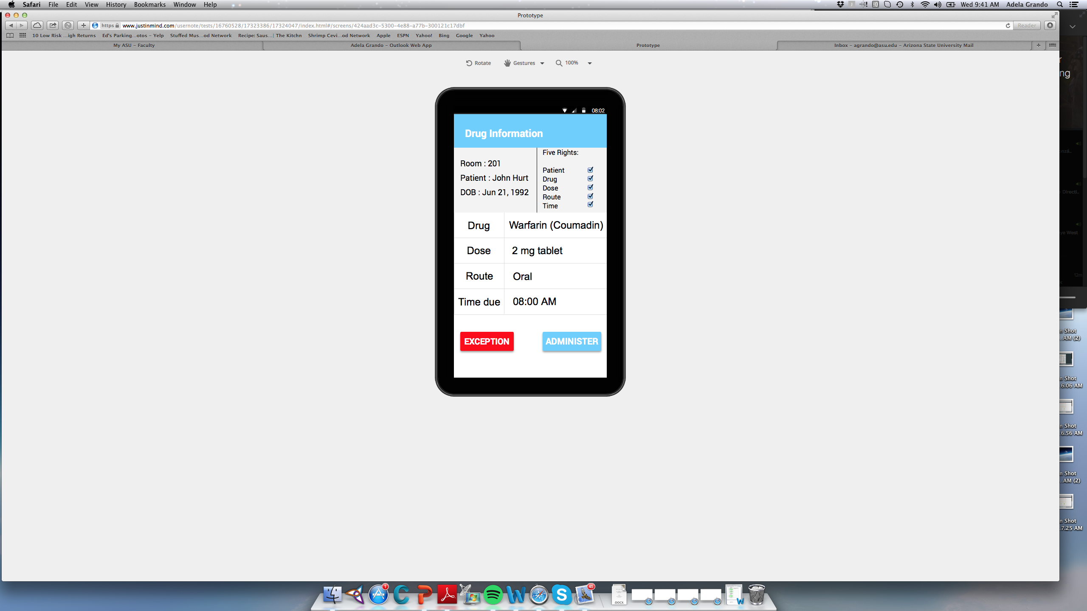
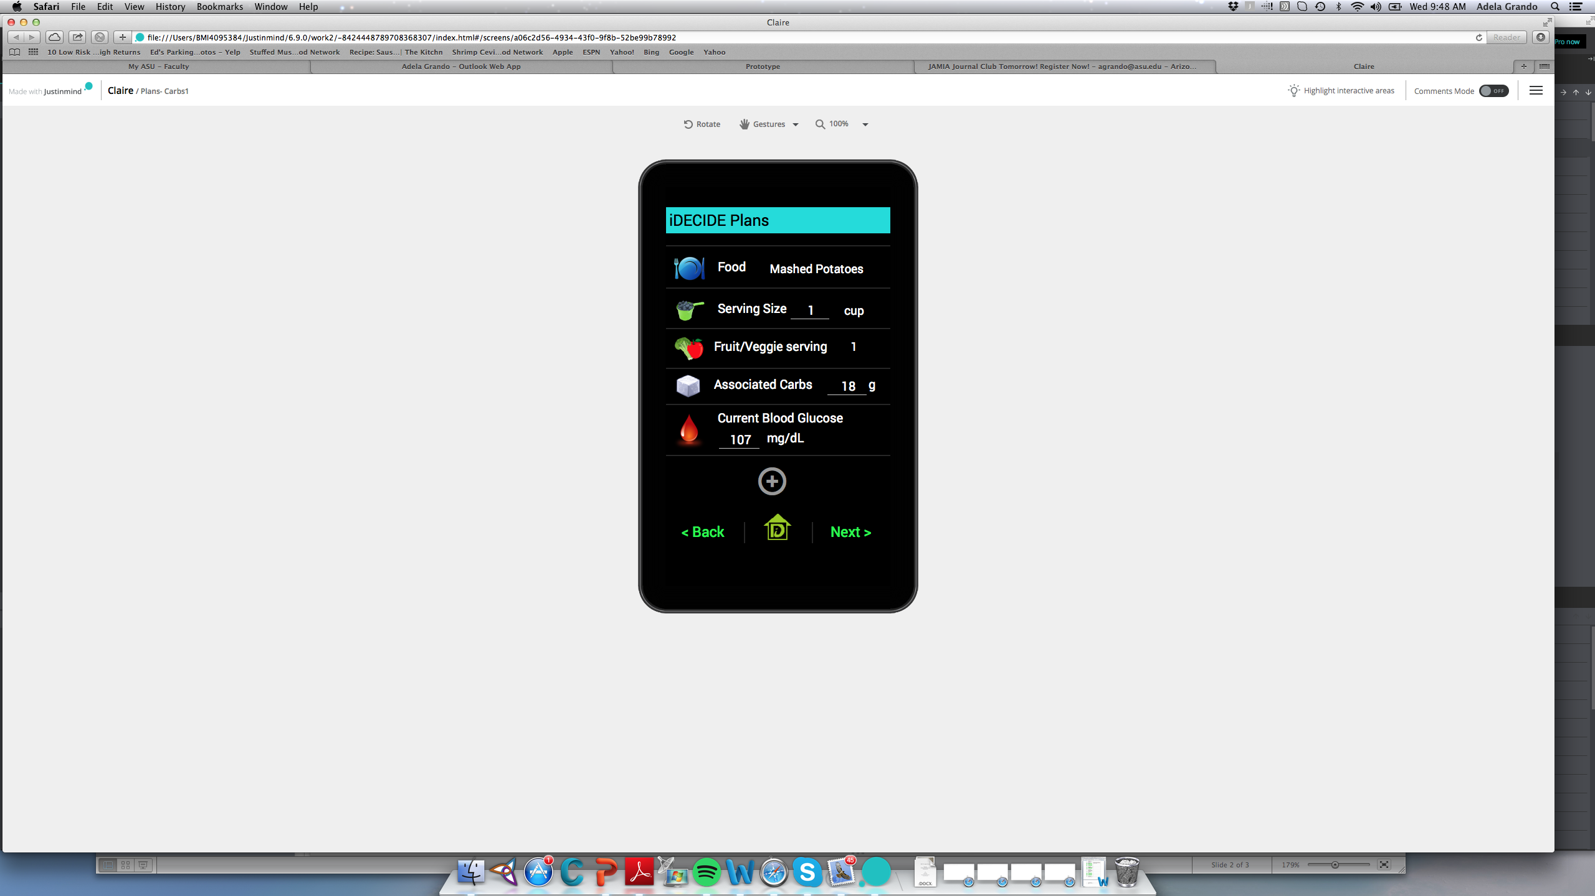
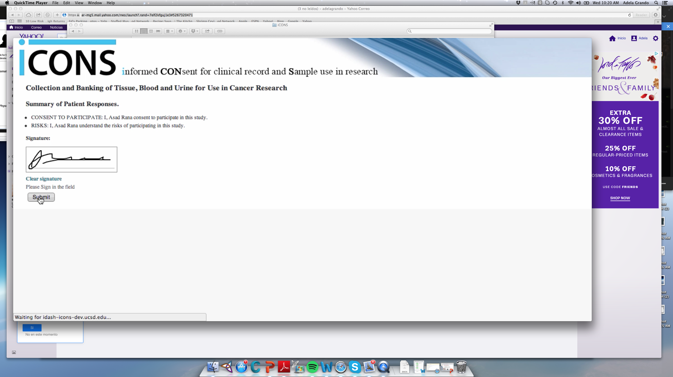
Smartphone app for s medication, reduce medication errors and
increase patient safety
Smartphone app for empowering diabetes patients to better control blood glucose
Tablet applications to support electronic informed consent models, that can be electronically signed, filed and retrieved

Slide 23

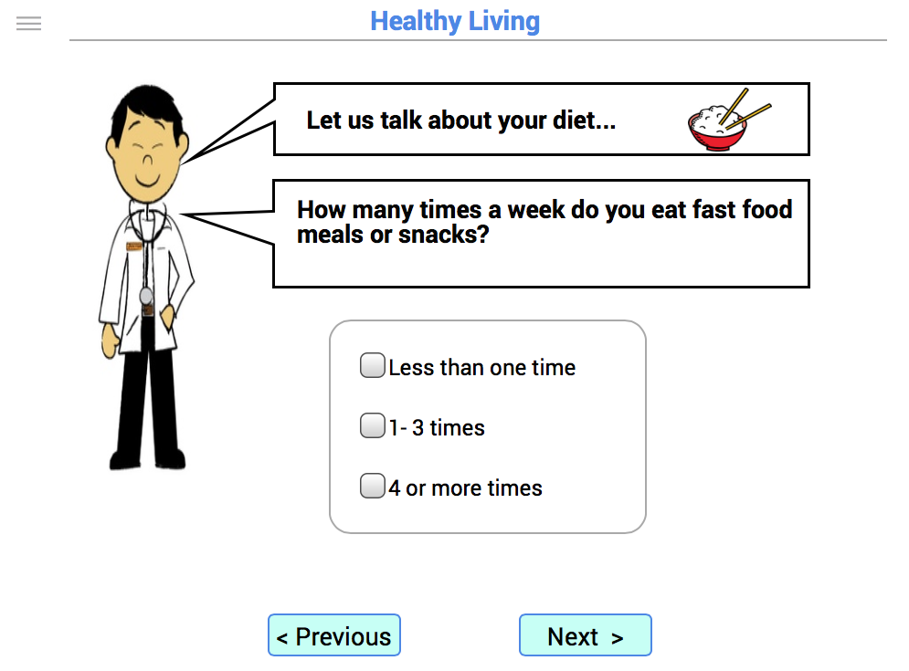

Slide 24
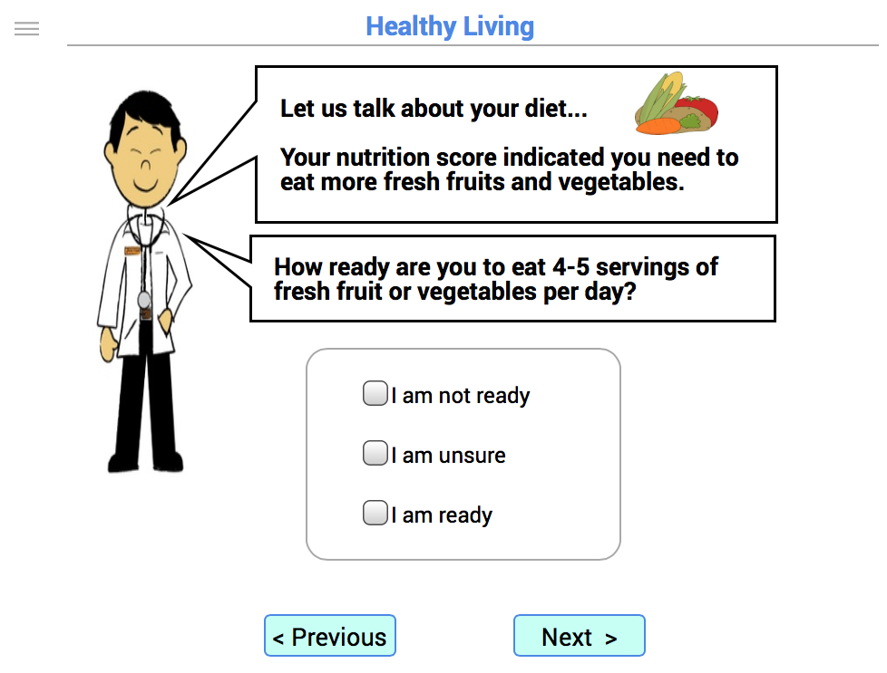

Slide 25
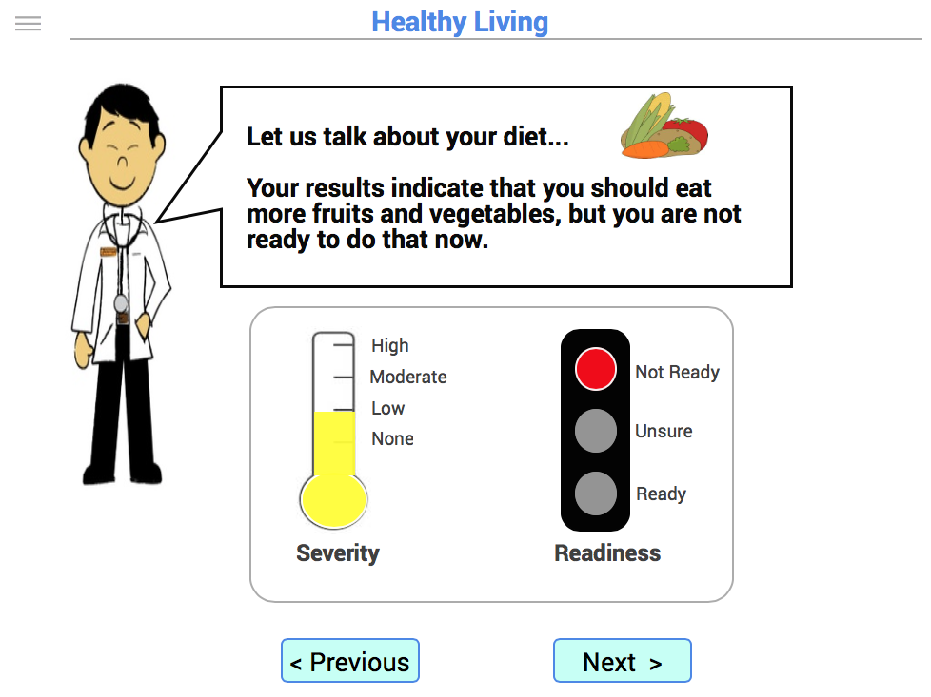

Slide 26
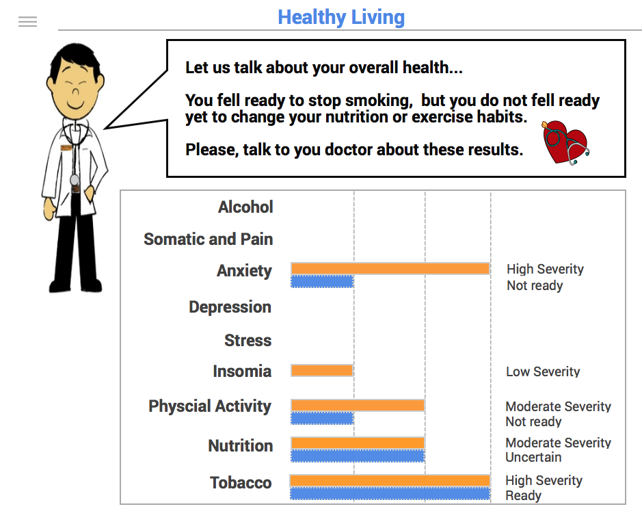

Slide 27
Treatment Recommendations
Cardiovascular Riisk
Disease
Lifestyle Problems and Readiness
Treatment Recommendations

Slide 28
Sample Training Modules
Module | Outcome
Depression, Anxiety and Trauma | Reduce symptoms
Nutrition | Improve fruit/vegetable intake
Physical Activity | Increase physical activity
Diabetes/Prediabetes | Reduce A1c or reverse diabetes
Hypertension | Reduce blood pressure, lipids
Insomnia | Improve sleep decrease fatigue
Alcohol abuse | Decrease or abstain from alcohol
Pain and physical symptoms | Decrease symptoms
Physician Interviewing | Patient engagement and motivaton

Slide 29
Health Coaching
Assess
5 A's
Shared decision making
Patient Practice self management
Condition
Motivate
Health Coach Follow up
Self-management

Slide 30
Health Solutions

Slide 31
Recommendations – Integrated Care
Transition health system to integrated care
Train and educate workforce
Use “stress” and culturally acceptable treatments (mindfulness, Tai Chi) for depression and somatic symptoms
Use health risk assessment, tailored treatment and population health follow-up
Add eHealth resources (mobile phone Apps)

Slide 32
Recommendations – Workforce Development
Train/educate:
  Government and hospital leaders on business case
  Physicians and residents in integrated care
  Social workers as Behavioral Health Consultants
  Public health students/graduates as health coaches

Slide 33
Workforce Development: Integrated Behavioral Health in Vietnam
Patient
Ministry of Health
Physician: Assess, Advise and Motivate
Social Worker: Complex cases
Public Health student: Health Coaching

Slide 34
Training and Education Programs Arizona State University
College of Health Solutions
Online continuing education
In-person training in Vietnam
Masters and doctoral degrees
Faculty and student exchange
Online Health Risk Assessment
Research collaboration
www.chs.asu.edu

Slide 35

Online Physician Continuing Education in Integrated Health
Integrating Behavioral Health into Primary Care
Controlled Substances and Pain in Primary Care
Integrating Behavioral Health into Pediatric Care
Working with Patient Families in Primary and Pediatric Care
http://links.asu.edu/ASUIntegratedBH

Slide 36
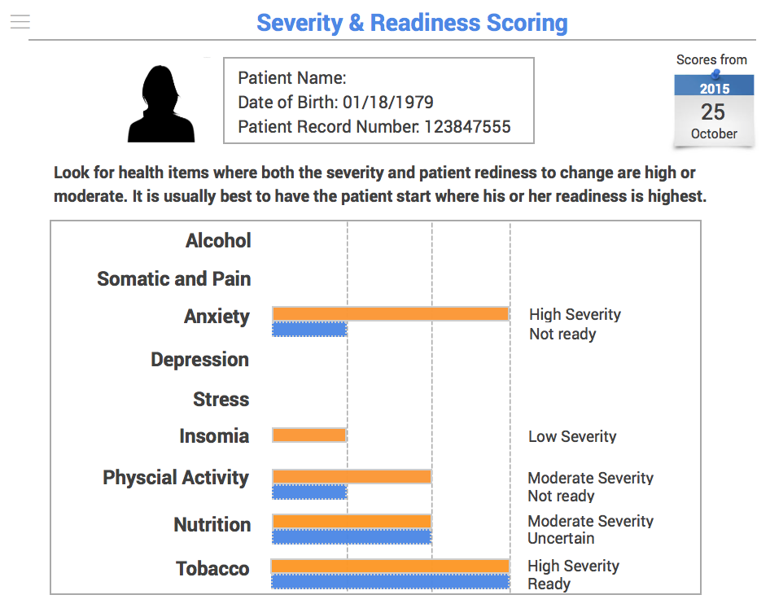
Online Health Risk Assessment and Coaching

Slide 37
ASU Master’s of Integrated Health Care (MIHC)
For future leaders of integrated health programs.
Focus on strategic planning, integrated care clinical practice, fiscal management
Quality improvement and Lean and Six Sigma, big data and business analytics

Slide 38
程
ASU Doctor of Behavioral Health (DBH)
Upgrade for master’s level clinicians
Online learning, Full or Part-time
Clinical or management concentration
Primary care or hospital internship
Replace dissertation with culminating project
Faculty practice topics they teach
www.chs.asu.edu/dbh

Slide 39
Research and Faculty/Student Exchange
Applied Clinical Research Partnership
  Practice-based research in hospital and primary care.
  How to tailor US integrated care for Vietnam.
Faculty and Student Exchange
  ASU and Mayo Clinic experts visit Vietnam for lecture and consultation.
  Vietnam experts visit ASU Phoenix Arizona
  Student exchange between ASU and Vietnam universities

Slide 40

Thank you!
Questions?
CALL TO ACTION / NEXT STEPS

