Slide 1
Caring for the caregiver
A workshop on health and wellness for caregivers
Diana crocker, ma, lac, DBH intern
breanna reeser, mhi, epC

Slide 2

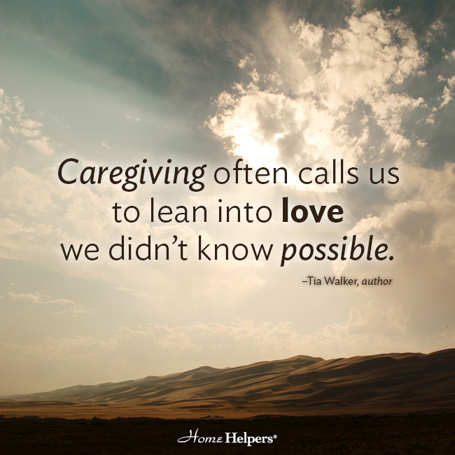
Why do we care?
(why do we do what we do?)
We chose this profession for different reasons:
Because our parents decided for us.
Because we want to make money (status).
Because we enjoy helping others.
Because we want to make a difference in the world.
I’m not sure yet…
Notes:
Pieterse, A. L., Lee, M., Ritmeester, A., & Collins, N. M. (2013). Towards a model of self-awareness development for counselling and psychotherapy training. Counselling Psychology Quarterly, 26(2), 190-207.

Slide 3
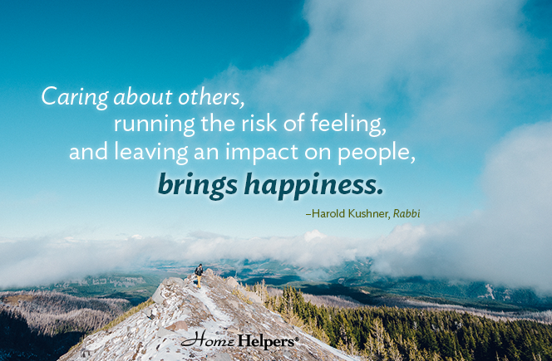
It is more than a job…it is a passion!
Regardless of the reason why you chose this career path, your job is to care for others but you must do it by setting the example yourself!

Slide 4

We are not silos with independent or separate needs.
Our needs are integrated
Each problem area affects other areas of our lives
What happens at home, we bring it to school, work, relationships, and our patients
Notes:
Lovallo, W. R. (2015). Stress and health: Biological and psychological interactions. Sage publications.

Slide 5

We are affected by everything around us and everything we do affect others
Every decision we make has an impact on other things and people, not just ourselves.
We cannot expect others to not affect us.
If what we do affect others and others affect us, we must take an integrated approach to life.
Notes:
Folkman, S. (2013). Stress: appraisal and coping. In Encyclopedia of behavioral medicine (pp. 1913-1915). Springer New York.
Lovallo, W. R. (2015). Stress and health: Biological and psychological interactions. Sage publications.

Slide 6
What happens when we do not take care of ourselves?
Mental health
Physical health
Relationships(personal and professional)
Organizational health
Notes:
Stults-Kolehmainen, M. A., & Sinha, R. (2014). The effects of stress on physical activity and exercise. Sports medicine, 44(1), 81-121.

Slide 7

challenges for Caregivers
As a caregiver, what challenges are you facing with prioritizing your own self-care?

Slide 8
Mental health
– Frustration, irritability, anxiety/fear, confusion, poor concentration, helplessness, hopelessness, depression, low morale, pessimism, compassion fatigue, guilt, etc.
Notes:
Gu, J., Strauss, C., Bond, R., & Cavanagh, K. (2015). How do mindfulness-based cognitive therapy and mindfulness-based stress reduction improve mental health and wellbeing? A systematic review and meta-analysis of mediation studies. Clinical psychology review, 37, 1-12.
Thoits, P. A. (2013). Self, identity, stress, and mental health. In Handbook of the sociology of mental health (pp. 357-377). Springer Netherlands.
VanKim, N. A., & Nelson, T. F. (2013). Vigorous physical activity, mental health, perceived stress, and socializing among college students. American Journal of Health Promotion, 28(1), 7-15.

Slide 9

Relationships(personal and professional)
Conflict, tension, misunderstanding, anger, emotional or physical abuse
Notes:
Beehr, T. A. (2014). Psychological stress in the workplace (psychology revivals). Routledge.

Slide 10
Organizational health
Increased absenteeism
Diminished productivity
Team conflict
Turnover
Notes:
Beehr, T. A. (2014). Psychological stress in the workplace (psychology revivals). Routledge.
Hassard, J., Teoh, K., Cox, T., Dewe, P., Cosmar, M., Gründler, R., ... & Van den Broek, K. (2014). Calculating the cost of work-related stress and psychosocial risks.
Kocakulah, M. C., Kelley, A. G., Mitchell, K. M., & Ruggieri, M. P. (2016). Absenteeism problems and costs: causes, effects and cures. The International Business & Economics Research Journal (Online), 15(3), 89.

Slide 11
Physical health
Stress-related illness (hypertension, ulcers, acid reflux/heartburn, skin rash, etc.)
Caregivers often experience headaches, back pain, insomnia, and arthritis
Notes:
Cooper, C. L., & Marshall, J. (2013). Occupational sources of stress: A review of the literature relating to coronary heart disease and mental ill health. In From Stress to Wellbeing Volume 1 (pp. 3-23). Palgrave Macmillan UK.

Slide 12




Strategies for Self Care
• Physiological:
• Nutrition
• Sleep
• Exercise -What is the best exercise for you ?
Notes:
Filaire, E., Dupuis, C., Galvaing, G., Aubreton, S., Laurent, H., Richard, R., & Filaire, M. (2013). Lung cancer: what are the links with oxidative stress, physical activity and nutrition. Lung Cancer, 82(3), 383-389.
Sano, A., Phillips, A. J., Amy, Z. Y., McHill, A. W., Taylor, S., Jaques, N., ... & Picard, R. W. (2015, June). Recognizing academic performance, sleep quality, stress level, and mental health using personality traits, wearable sensors and mobile phones. In Wearable and Implantable Body Sensor Networks (BSN), 2015 IEEE 12th International Conference on (pp. 1-6). IEEE.
Younkin, F. L., Axtell, E. A., & Anderton, C. R. (2017). Stress and Sleep Quality: Mediating Effects of Social Support.

Slide 13
Exercise & Self Care
Beyond weight control
Breana Reeser, EP-C
Chronic
Conditions
Mental Health
Physical Health
Decreased Anxiety & Depression
Improved Cognitive Function
Enhanced feelings of Well-being
Enhanced Physical Function & Independent Living in Older Adults
Prevention or Mitigation of functional Limitations
Effective Therapy for Many Chronic Diseases in Older Adults
American College of Sports Medicine 2017

Slide 14
Cognitive/Behavioral Self-Care
Acknowledge and validate your thoughts, worries, concerns - give your feelings an outlet
Take mental breaks
Evaluate your expectations/acknowledge limits
Set healthy boundaries Prioritize and delegate tasks
ASK FOR HELP!!!
Notes:
Freedland, K. E., Carney, R. M., Rich, M. W., Steinmeyer, B. C., & Rubin, E. H. (2015). Cognitive behavior therapy for depression and self-care in heart failure patients: a randomized clinical trial. JAMA internal medicine, 175(11), 1773-1782.

Slide 15
Cognitive/Behavioral Self-Care
Check
Check your attitude
Find
Find humor in the situation
Schedule
Schedule time for yourself, including respite care
Receive
Receive affection regularly (don’t just give)
Practice
Practice relaxation exercises
Engage in
Engage in pleasurable activities/ Build in play!
Notes:
Freedland, K. E., Carney, R. M., Rich, M. W., Steinmeyer, B. C., & Rubin, E. H. (2015). Cognitive behavior therapy for depression and self-care in heart failure patients: a randomized clinical trial. JAMA internal medicine, 175(11), 1773-1782.
Ho, F. Y. Y., Chung, K. F., Yeung, W. F., Ng, T. H., Kwan, K. S., Yung, K. P., & Cheng, S. K. (2015). Self-help cognitive-behavioral therapy for insomnia: a meta-analysis of randomized controlled trials. Sleep medicine reviews, 19, 17-28.

Slide 16

Questions?

Slide 17
Self-Care Action Plan
Q- What are two strategies that I plan to practice regularly to promote self-care?
01
Q- What barriers do I foresee encountering as I try to implement these strategies?
02
Q- What assistance do I need in order to overcome these barriers?
03
Q- When (and how often) will I begin practicing these strategies? First step?
04
Q- Who can help hold me accountable (self-care “buddy”)?
05

Slide 18
Wellness Websites
• General Health: www.cdc.gov www.heart.org
• Fitness: www.acefitness.org www.fitness.gov
• Food & Nutrition: www.myplate.gov www.advancingyourhealth.org/blogs
www.fruitsandveggiesmorematters.org www.sparkpeople.com www.myfitnesspal.com

Slide 19
Caregiving REsources
Caregiver Survival Resources – www.caregiver911.com
Family Caregiver Alliance – www.caregiving.com
Healthy Caregiver – www.healthycaregiver.com
National Alliance for Caregiving - www.caregiving.org

